Slide 1
Characterization of 3D organelle motion using curve fitting and clustering by unsupervised machine learning
Student: Huining Liang, University of Delaware
Mentor: Dr. Chandra Kambhamettu, University of Delaware
Dr. Jeffrey Caplan, University of Delaware
Date 12/11/2024

Slide 2
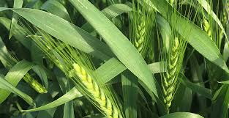
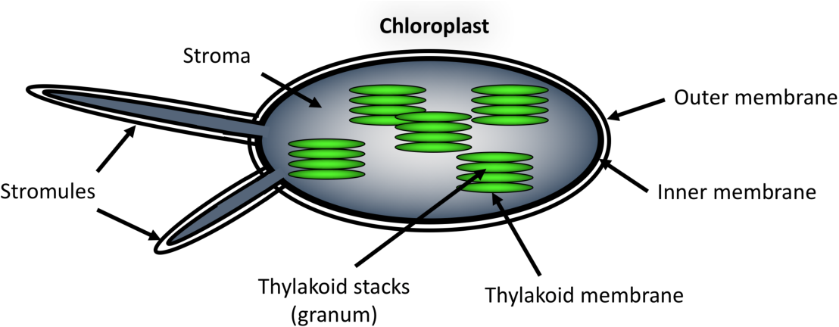
Characterization of 3D organelle motion using curve fitting and clustering by unsupervised machine learning

Slide 3
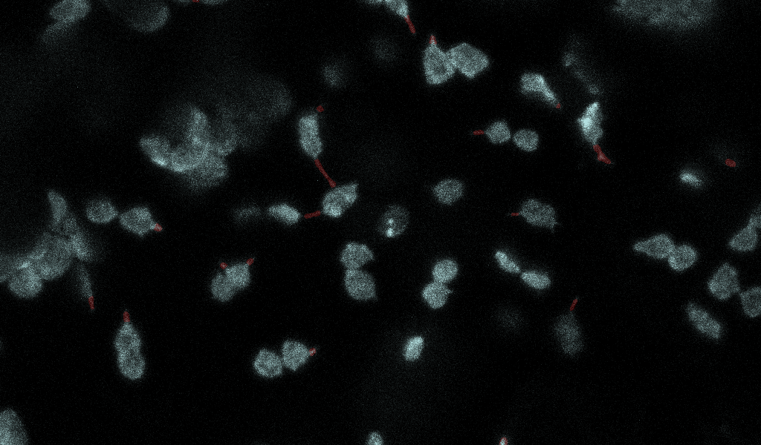
Characterization of 3D organelle motion using curve fitting and clustering by unsupervised machine learning
1809_01_Maximum intensity projection_movie

Slide 4
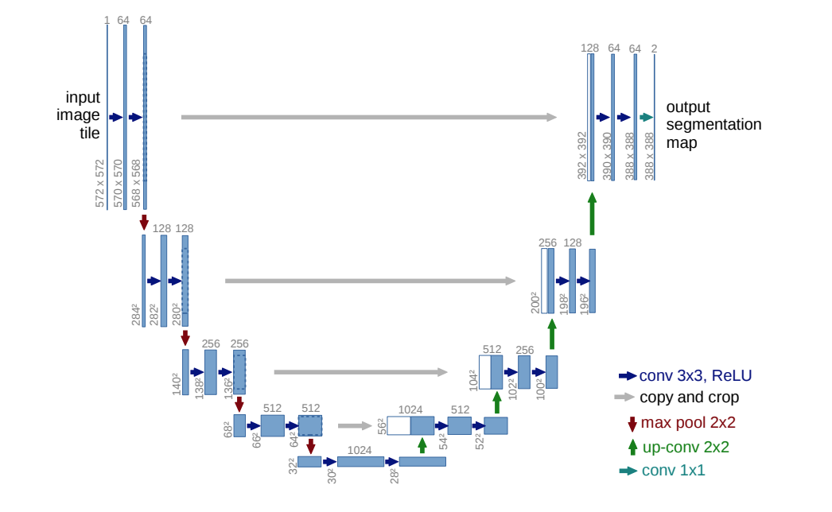
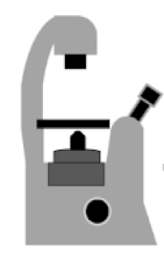
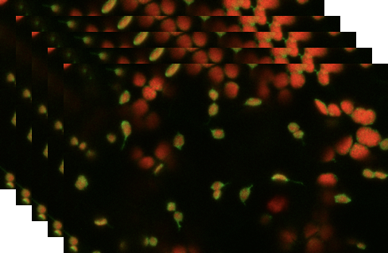
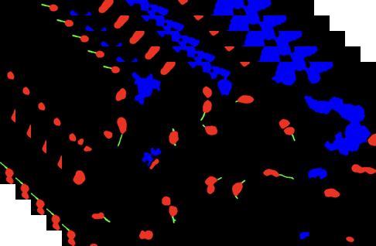
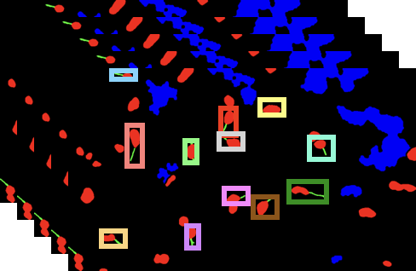
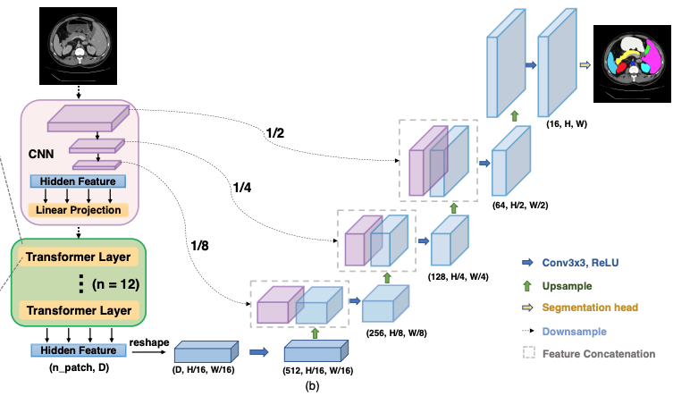
Characterization of 3D organelle motion using curve fitting and clustering by unsupervised machine learning
Data acquisition
Segmentation
Detection & Tracking
Old Pipeline
Snake Algorithm
Unet
TransUnet
New Pipeline
TrackFormer

Slide 5
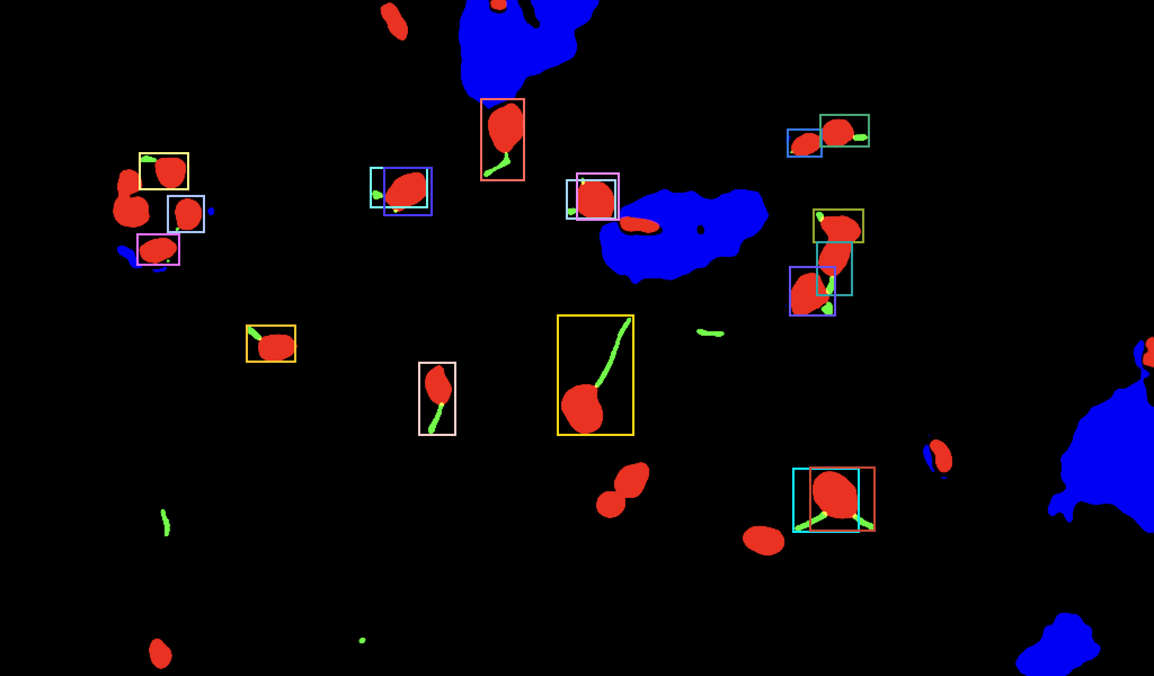
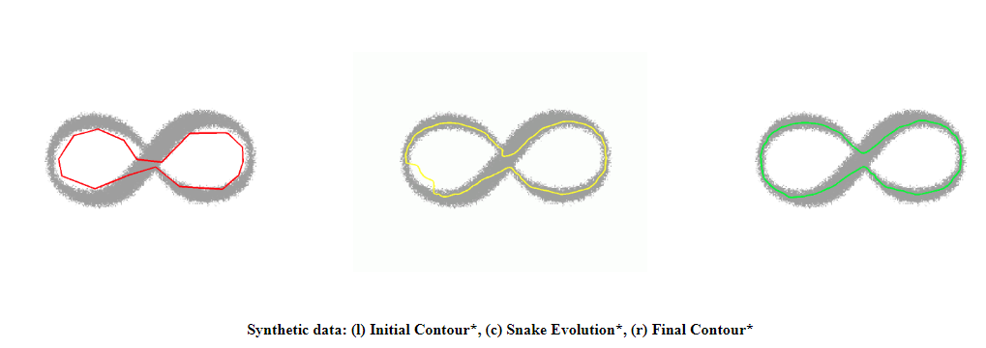
Characterization of 3D organelle motion using curve fitting and clustering by unsupervised machine learning
  Active Contours
  Select control points initialized with the stromule mask
  Update these control points via joint energy minimization
Internal energies - Smoothness constraints
External energies - Maximize distances from the edge of the segmented stromule
  Track these control points for stromule motion data

Slide 6

Characterization of 3D organelle motion using curve fitting and clustering by unsupervised machine learning
  Frame t
  Frame t+1
$$V_{t}=\frac{\sqrt{{(\text{x}\text{t}\text{+1}−\text{x}\text{t})}^{2}+{(\text{y}\text{t}\text{+1}−\text{y}\text{t})}^{2}}}{∆t}$$
(x_{b},y_{b})
(x_{b+1},y_{b+1})
  Stromule motion data
  -Base/Tip Speed
  -Acceleration
  -Movement Angle
  -Length change
(x_{t},y_{t})
(x_{t+1},y_{t+1})
  Active Contours
  Select control points initialized with the stromule mask
  Update these control points via joint energy minimization
Internal energies - Smoothness constraints
External energies - Maximize distances from the edge of the segmented stromule
  Track these control points for stromule motion data

Slide 7
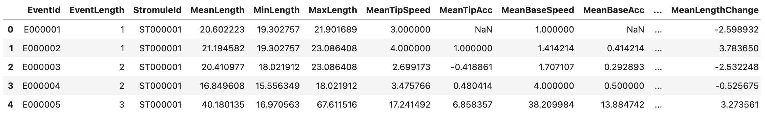
Characterization of 3D organelle motion using curve fitting and clustering by unsupervised machine learning

Slide 8
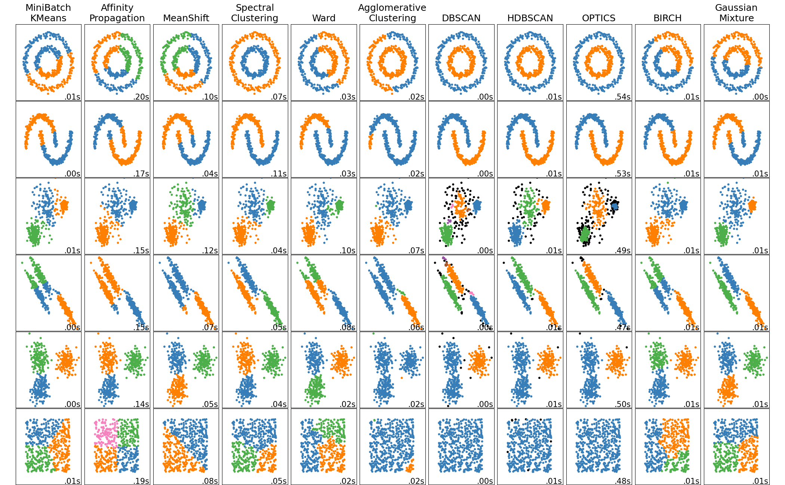
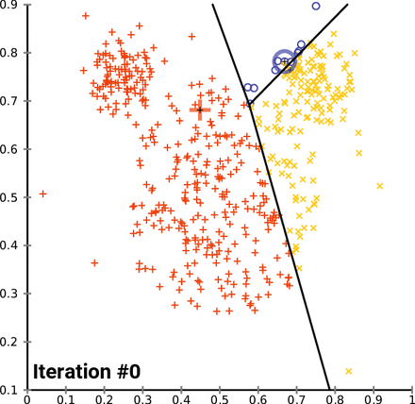
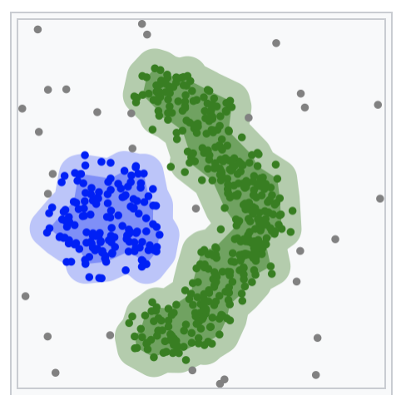
Characterization of 3D organelle motion using curve fitting and clustering by unsupervised machine learning
  Unsupervised machine learning methods for stromule motion data analysis
  K-Means
  DBSCAN

Slide 9
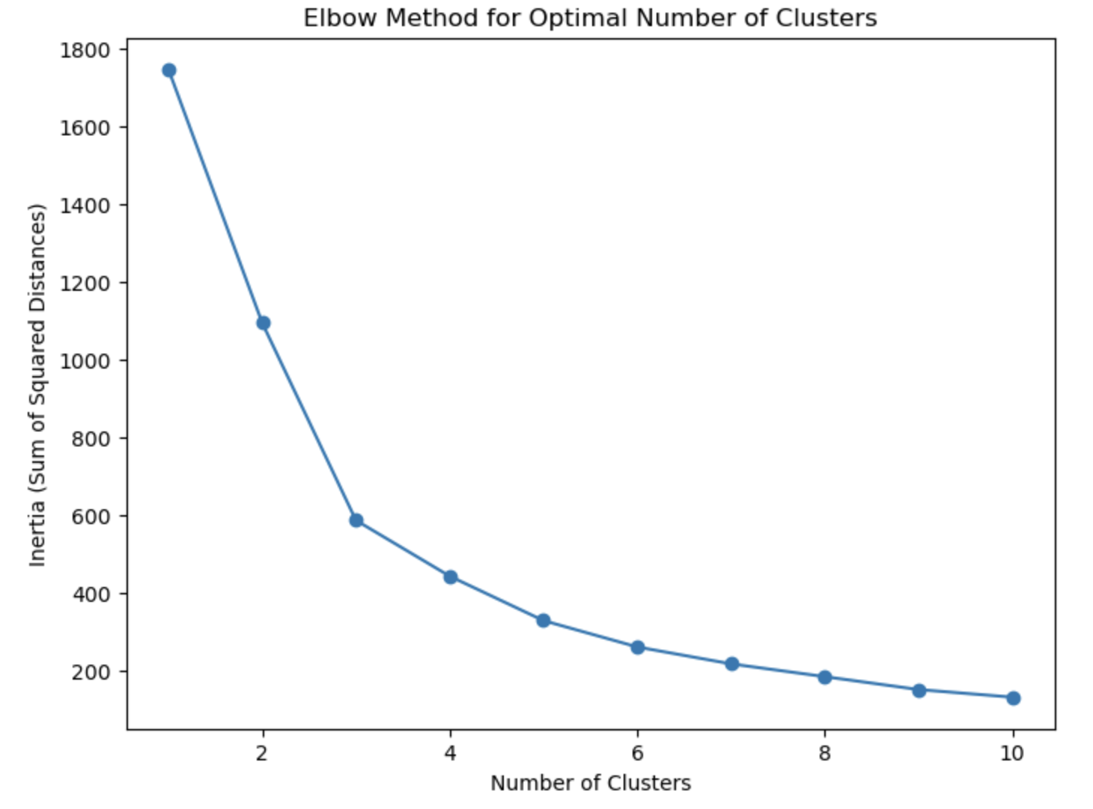
Characterization of 3D organelle motion using curve fitting and clustering by unsupervised machine learning
  K-Means
  1. Initialization: Choose K initial centroids.
  2. Assignment: Assign data points to the nearest centroid.
  3. Update: Recalculate the centroids as the mean of assigned points.
  4.Repeat: Repeat assignment and update steps until convergence.

Slide 10
Characterization of 3D organelle motion using curve fitting and clustering by unsupervised machine learning
  DBSCAN
  DBSCAN is a popular density-based clustering algorithm that groups data points based on their density in the feature space.
  1.Pick an unvisited point.
  2. Find all points within ϵ-radius of the point.
  3. Classify the point: If it has at least min Pts neighbors, it is a core point and forms a cluster. If fewer neighbors, it’s labeled as noise.
  4. Expand the cluster: For core points, recursively add neighboring points to the cluster if they are core points.
  5. Repeat until all points are visited.
  DBSCAN (Density-Based Spatial Clustering of Applications with Noise)

Slide 11
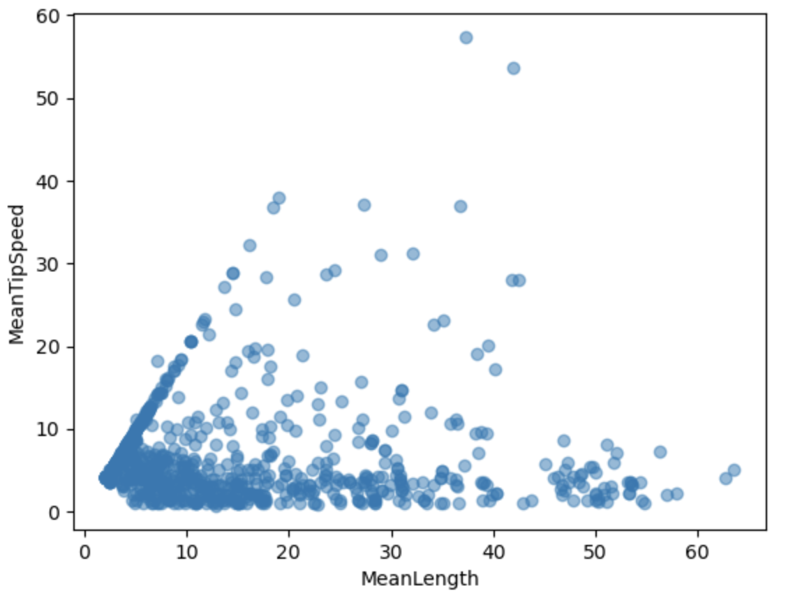
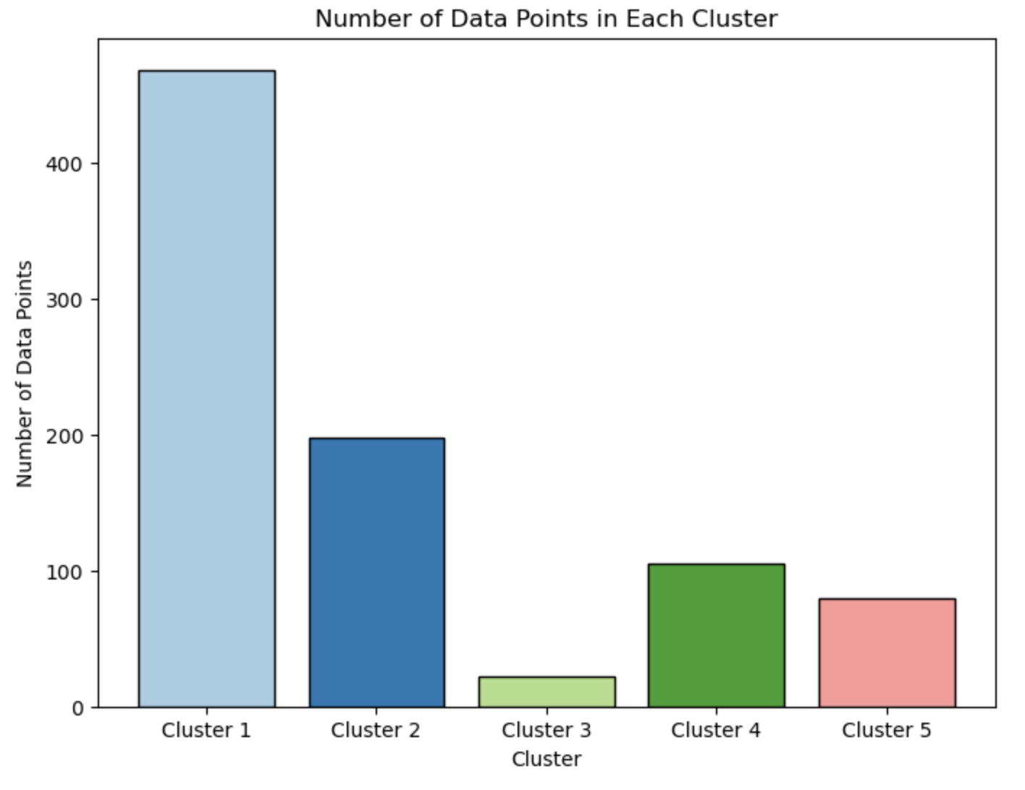
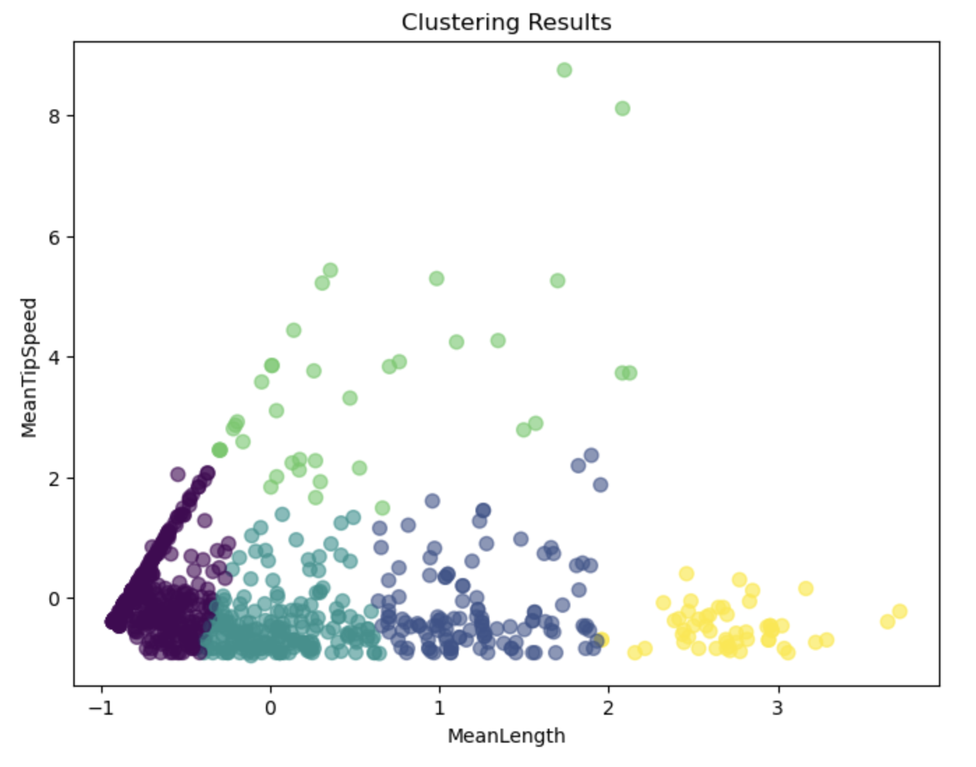
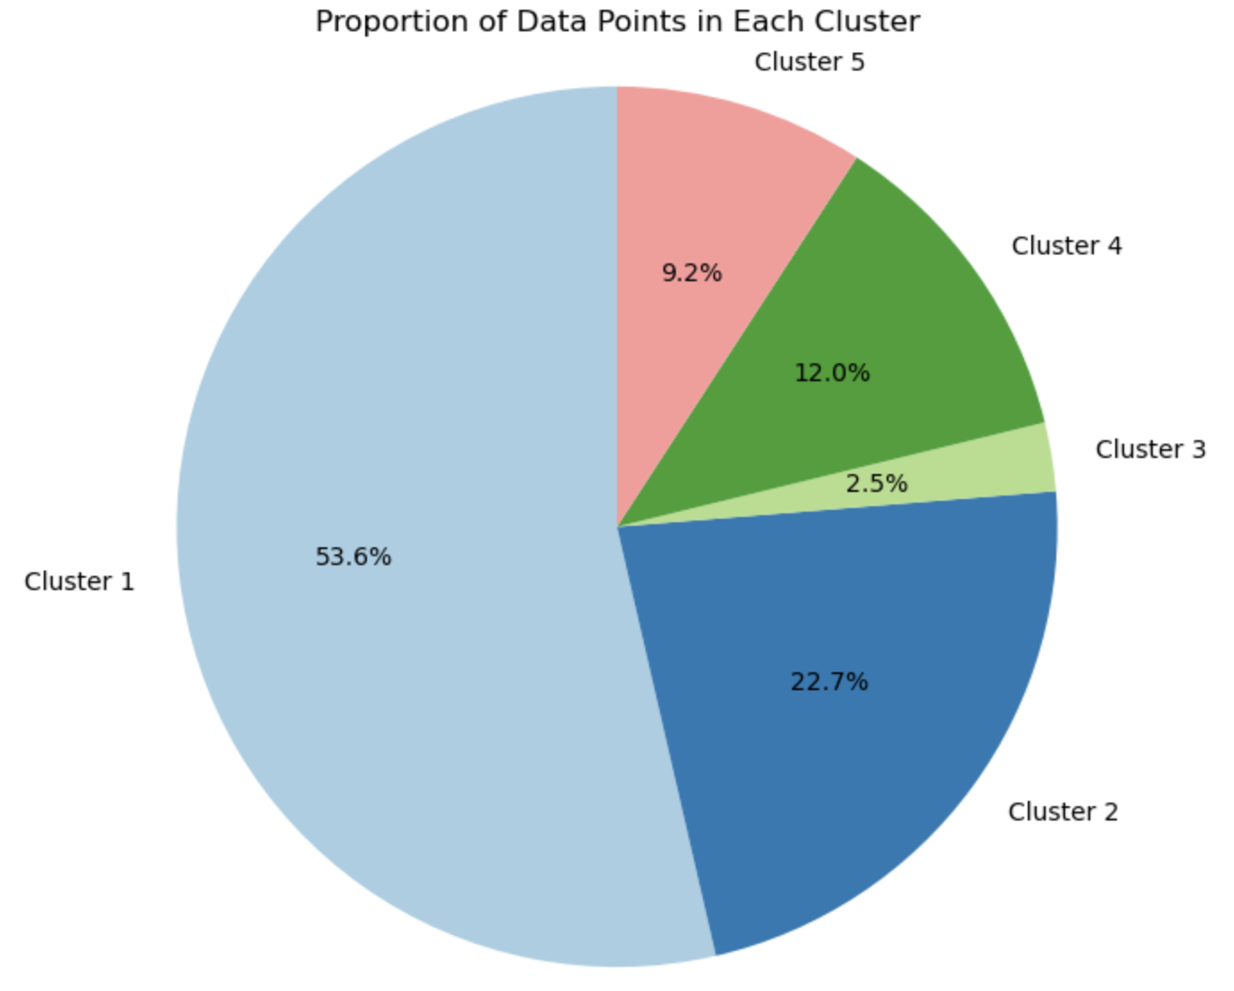
Characterization of 3D organelle motion using curve fitting and clustering by unsupervised machine learning

Slide 12
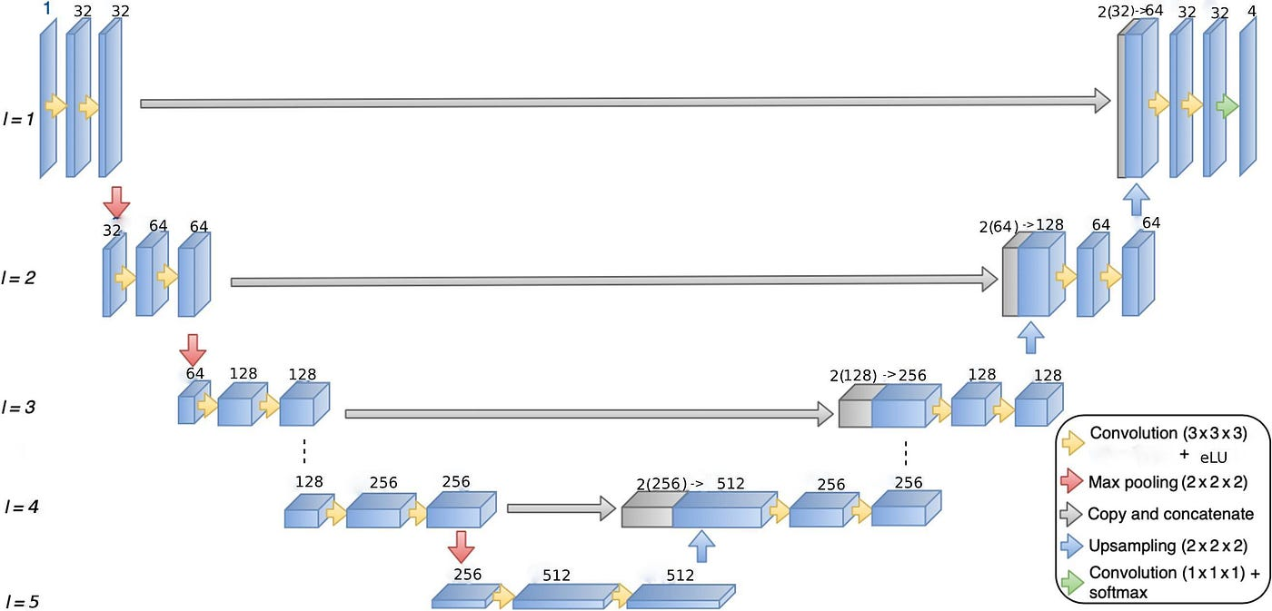
Characterization of 3D organelle motion using curve fitting and clustering by unsupervised machine learning
  3D Unet for Multi-class Plant Cell Organelle Segmentation

Slide 13
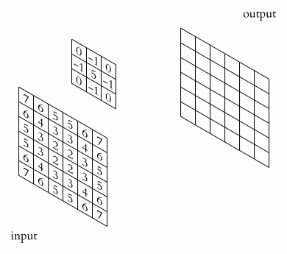
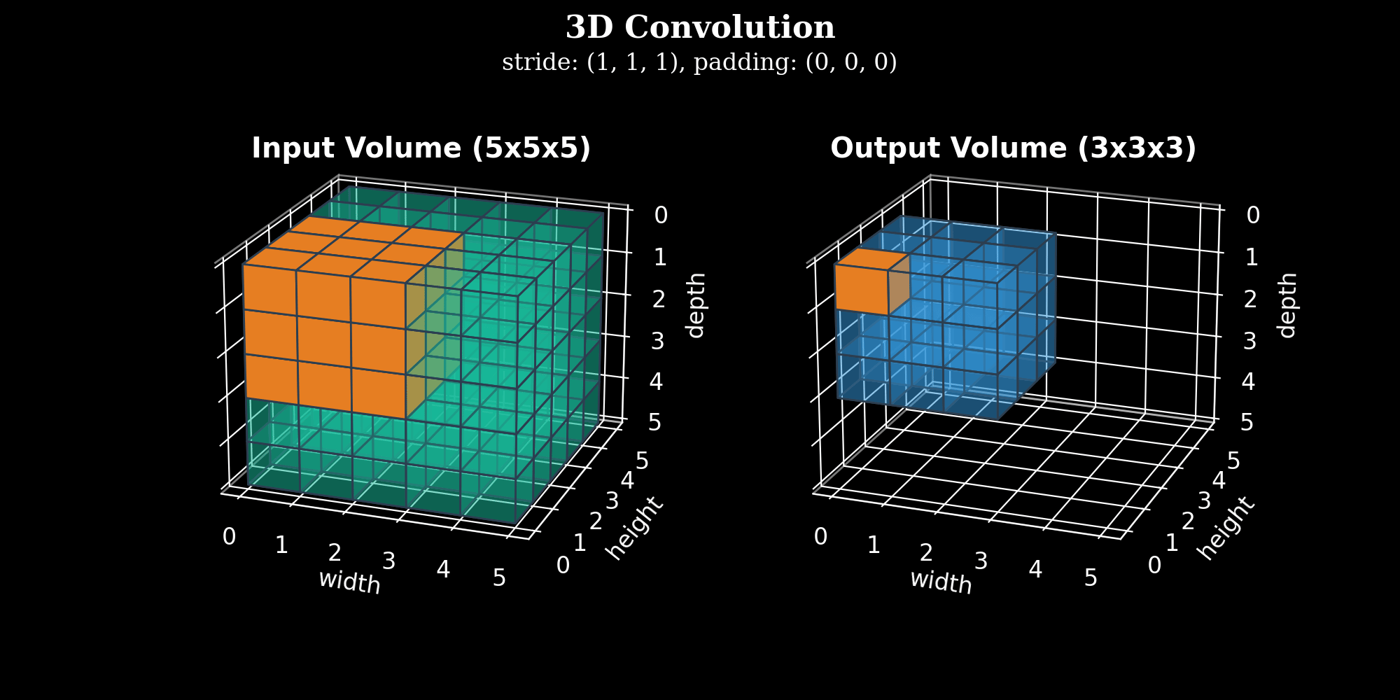
Characterization of 3D organelle motion using curve fitting and clustering by unsupervised machine learning
  3D Unet for Multi-class Plant Cell Organelle Segmentation

Slide 14
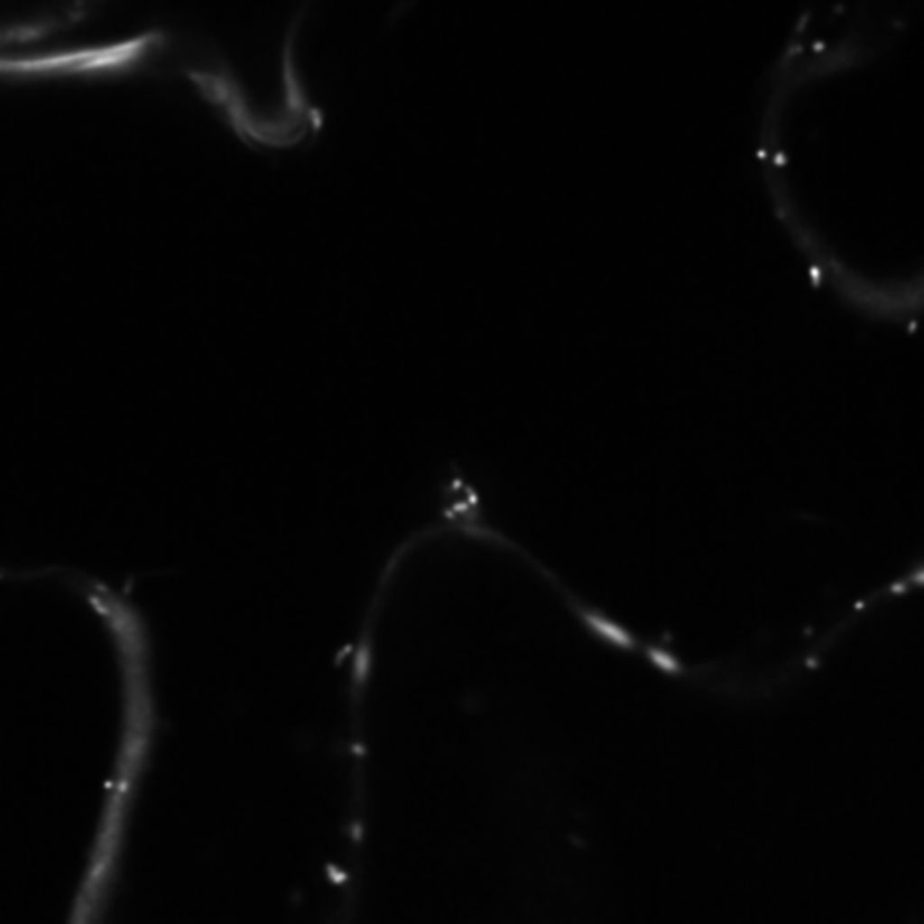
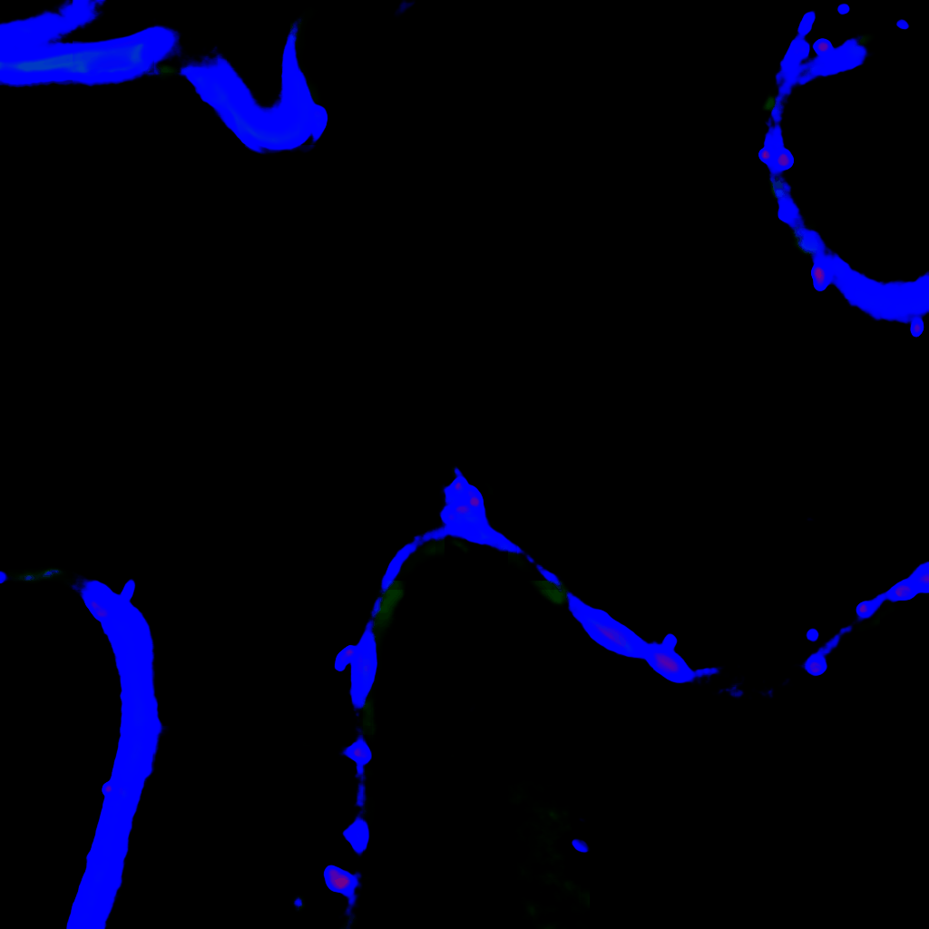
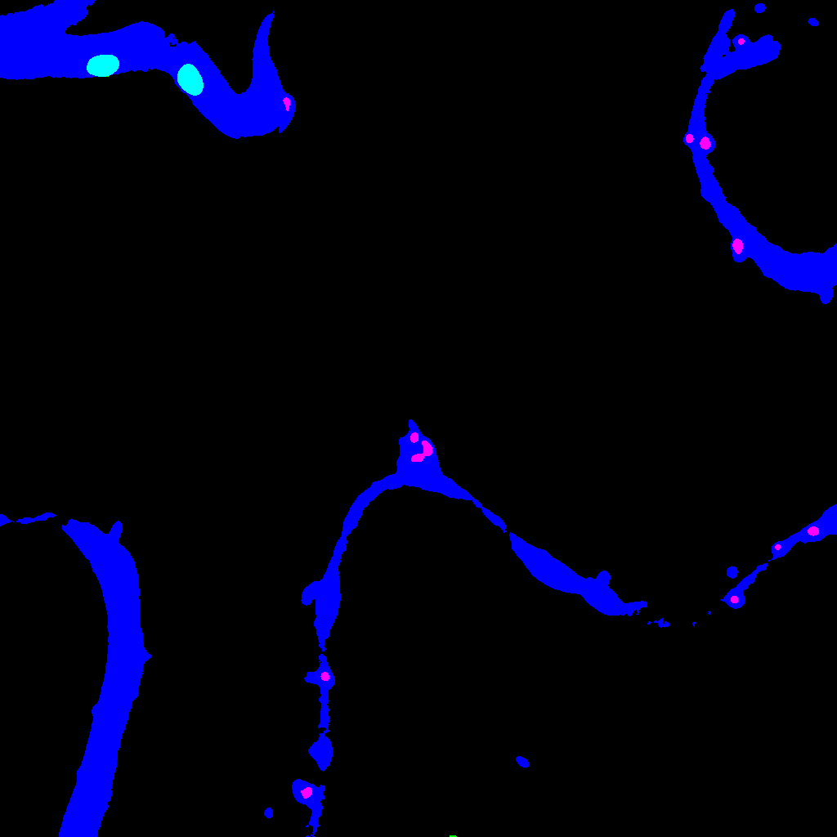
Characterization of 3D organelle motion using curve fitting and clustering by unsupervised machine learning
  Input
  Prediction
  Ground Truth

Slide 15
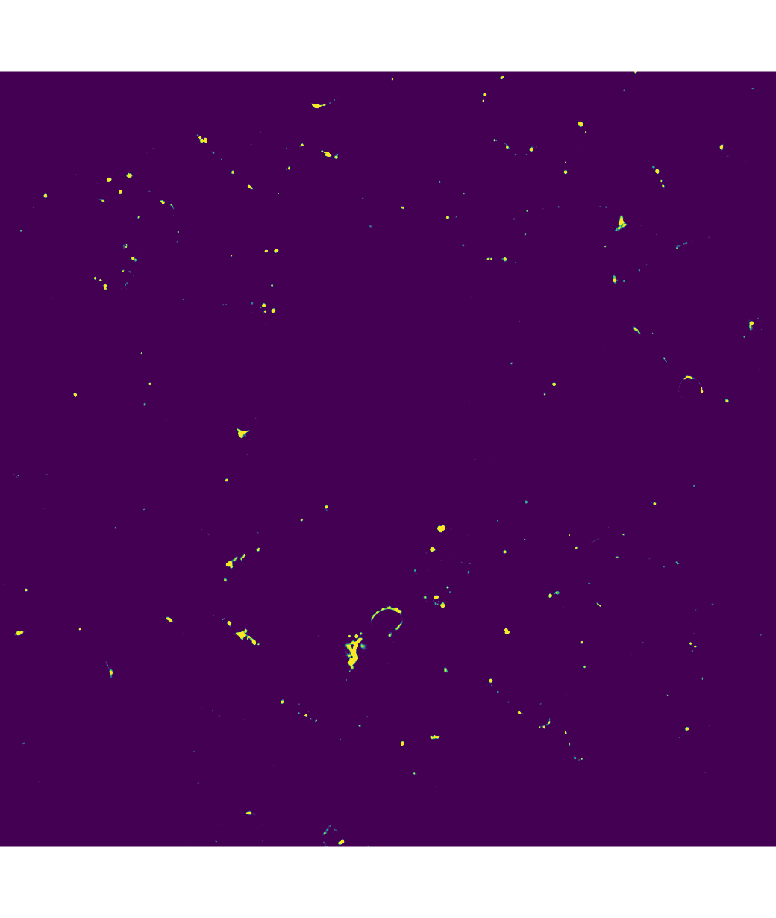
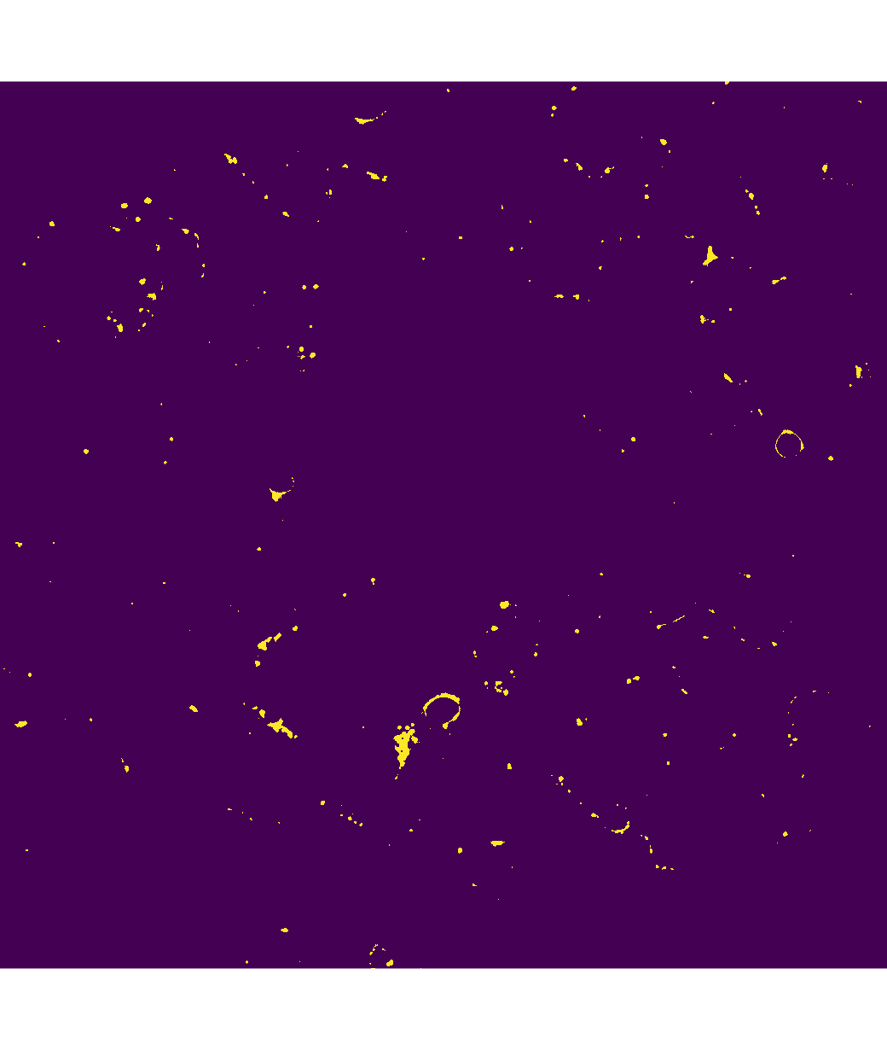
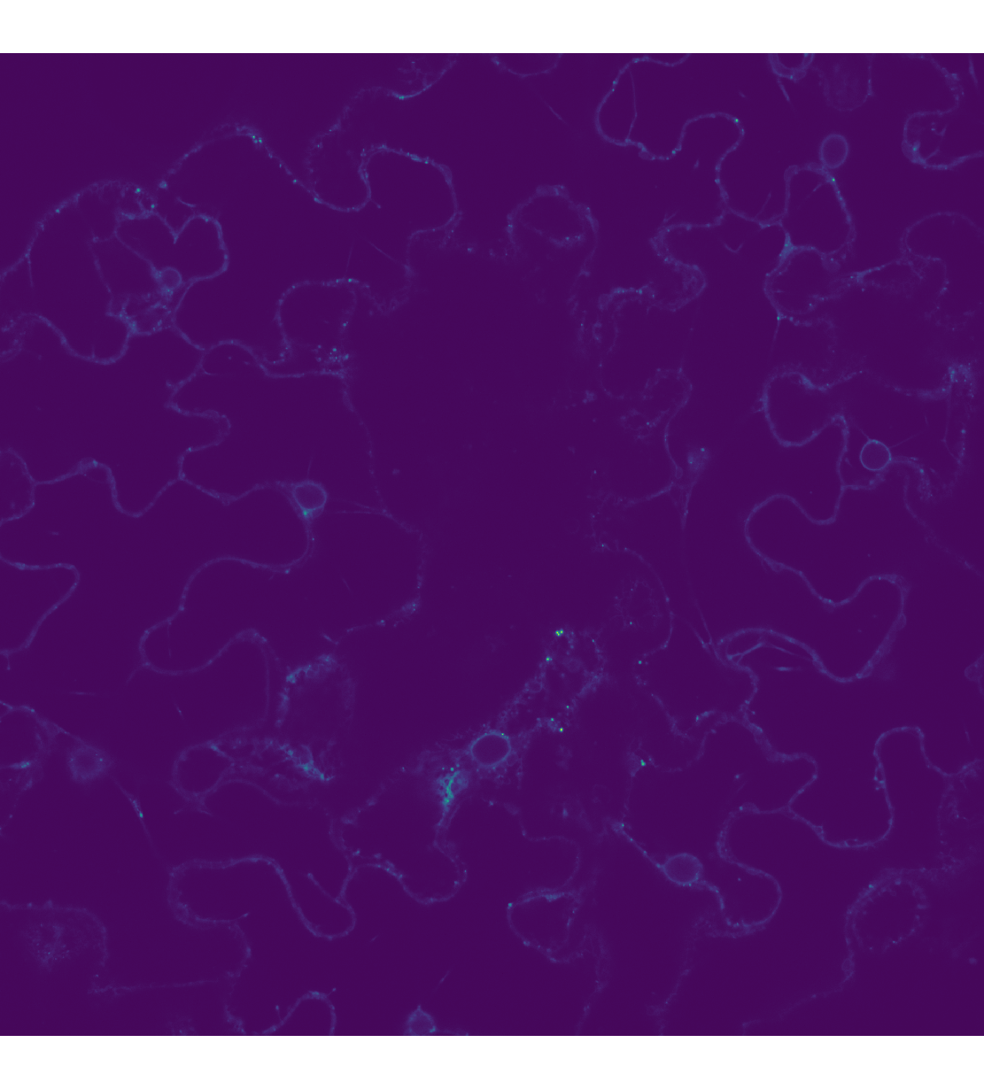
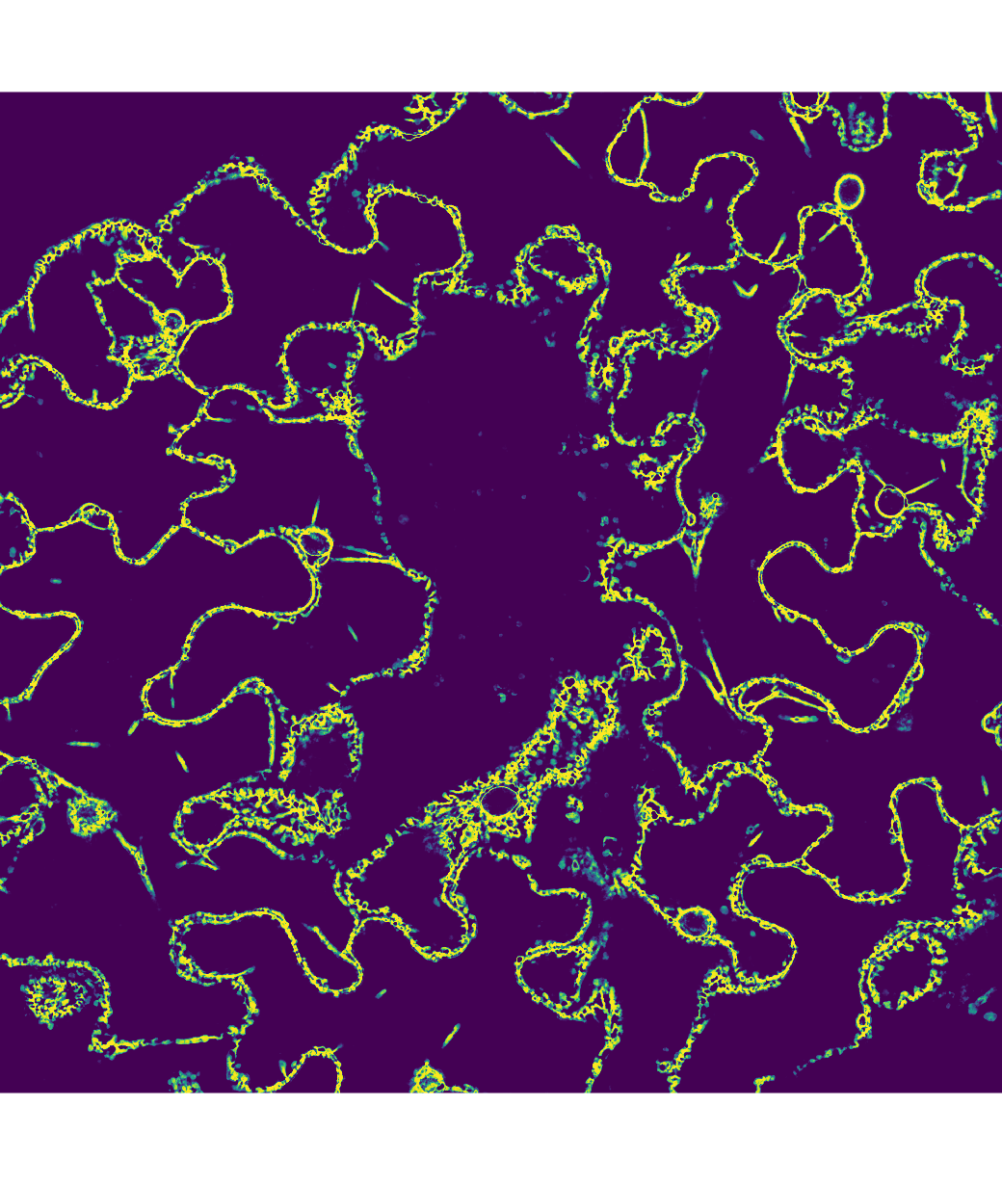
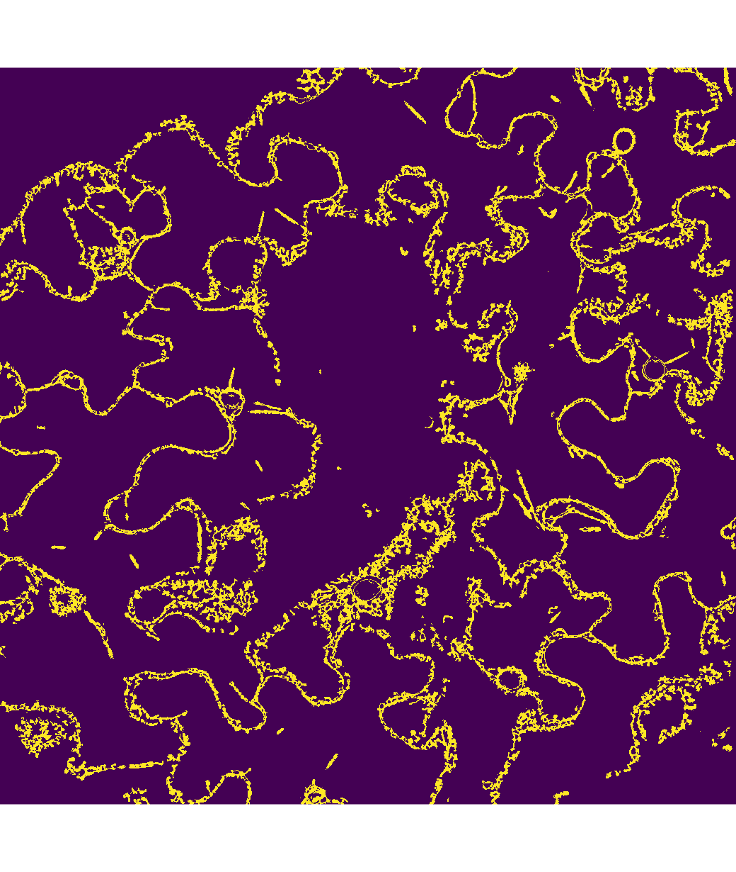
Characterization of 3D organelle motion using curve fitting and clustering by unsupervised machine learning
  Input
  Prediction
  Ground Truth

Slide 16
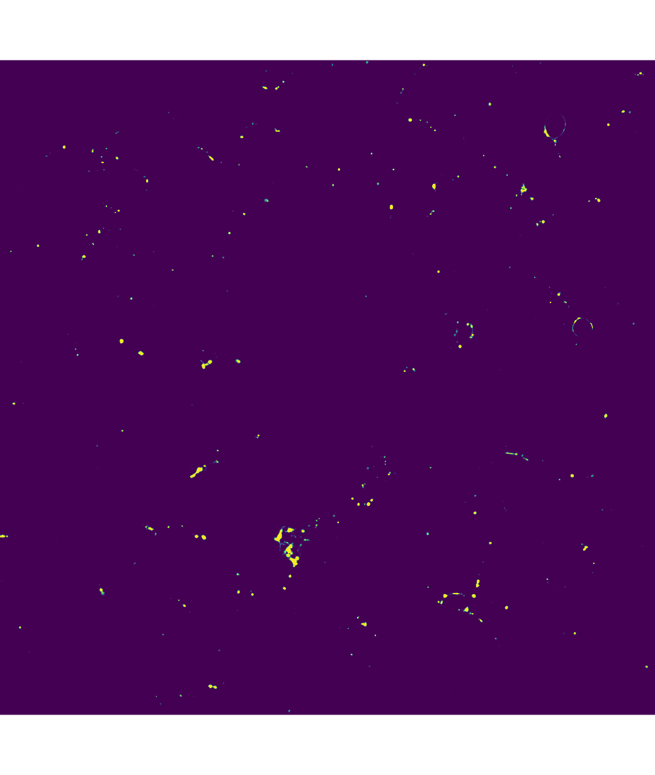
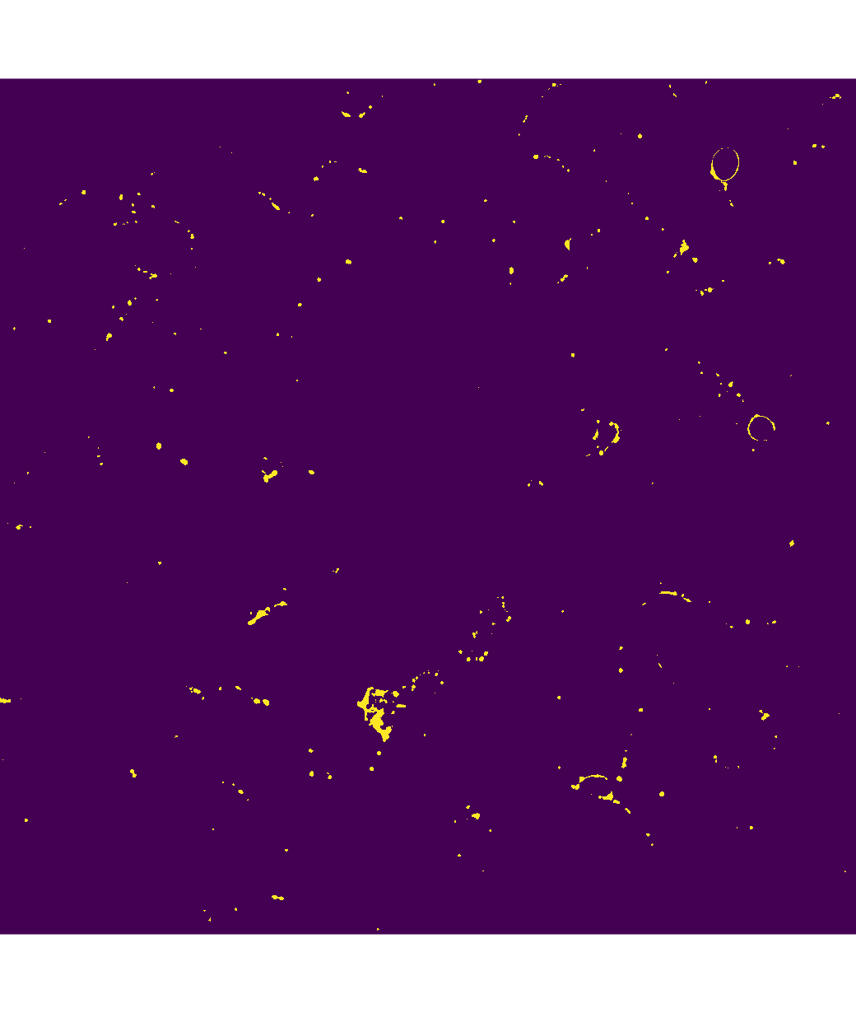
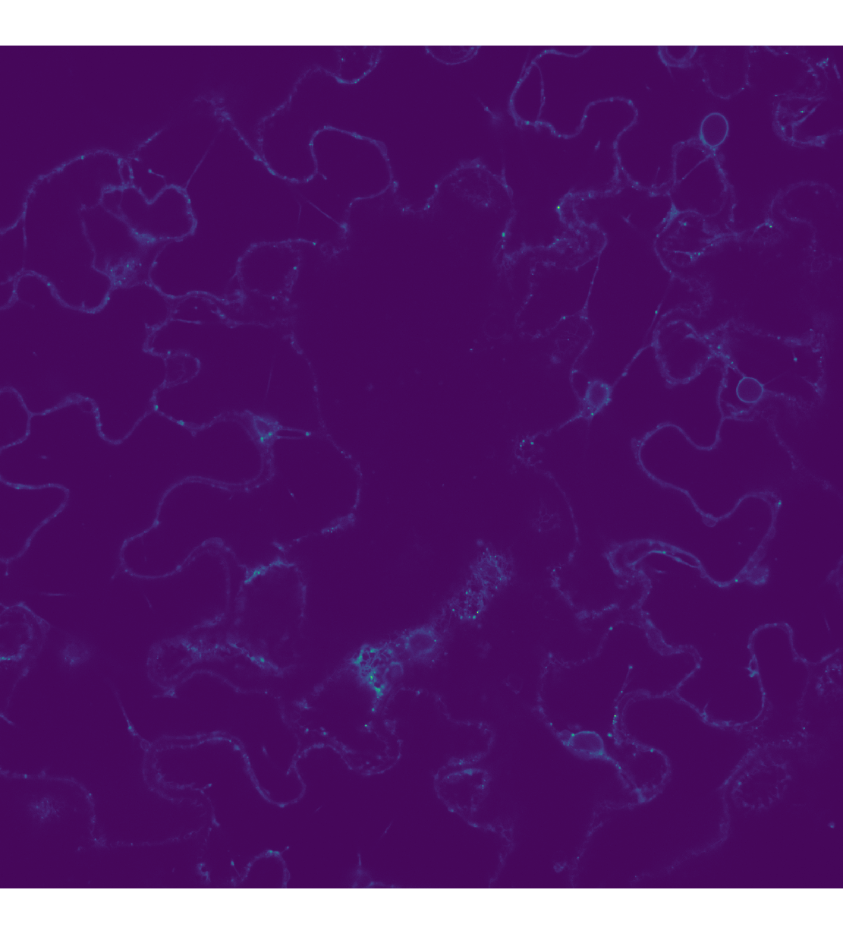
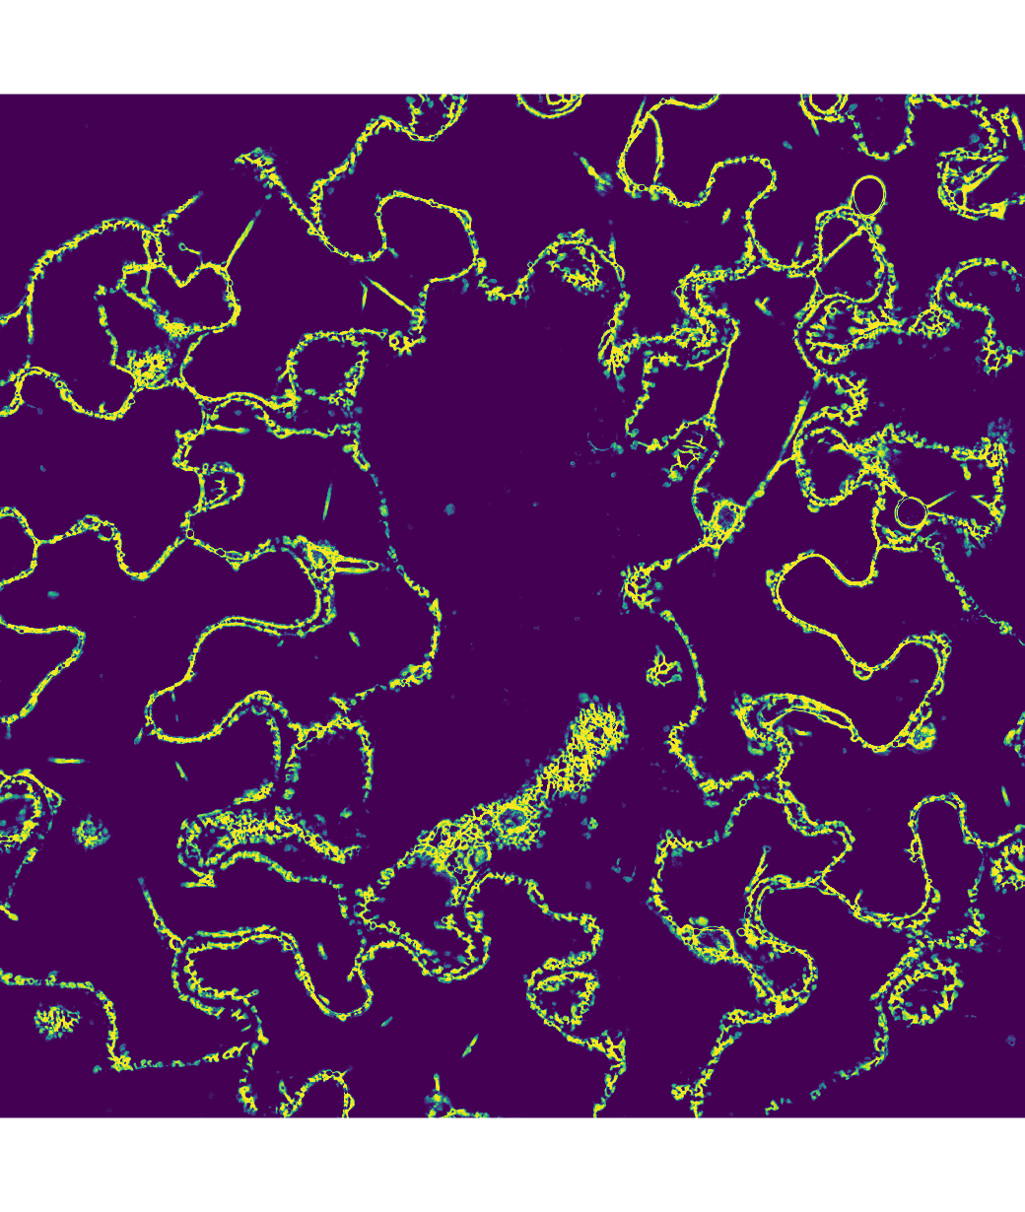
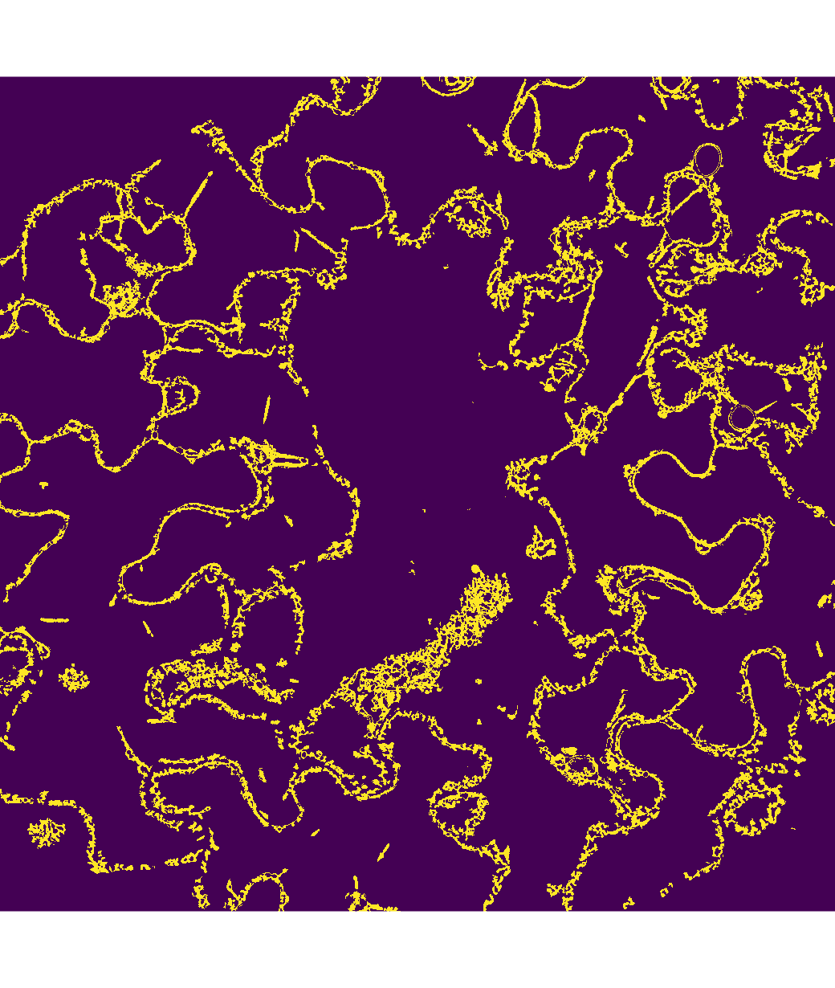
Characterization of 3D organelle motion using curve fitting and clustering by unsupervised machine learning
  Input
  Prediction
  Ground Truth

Slide 17
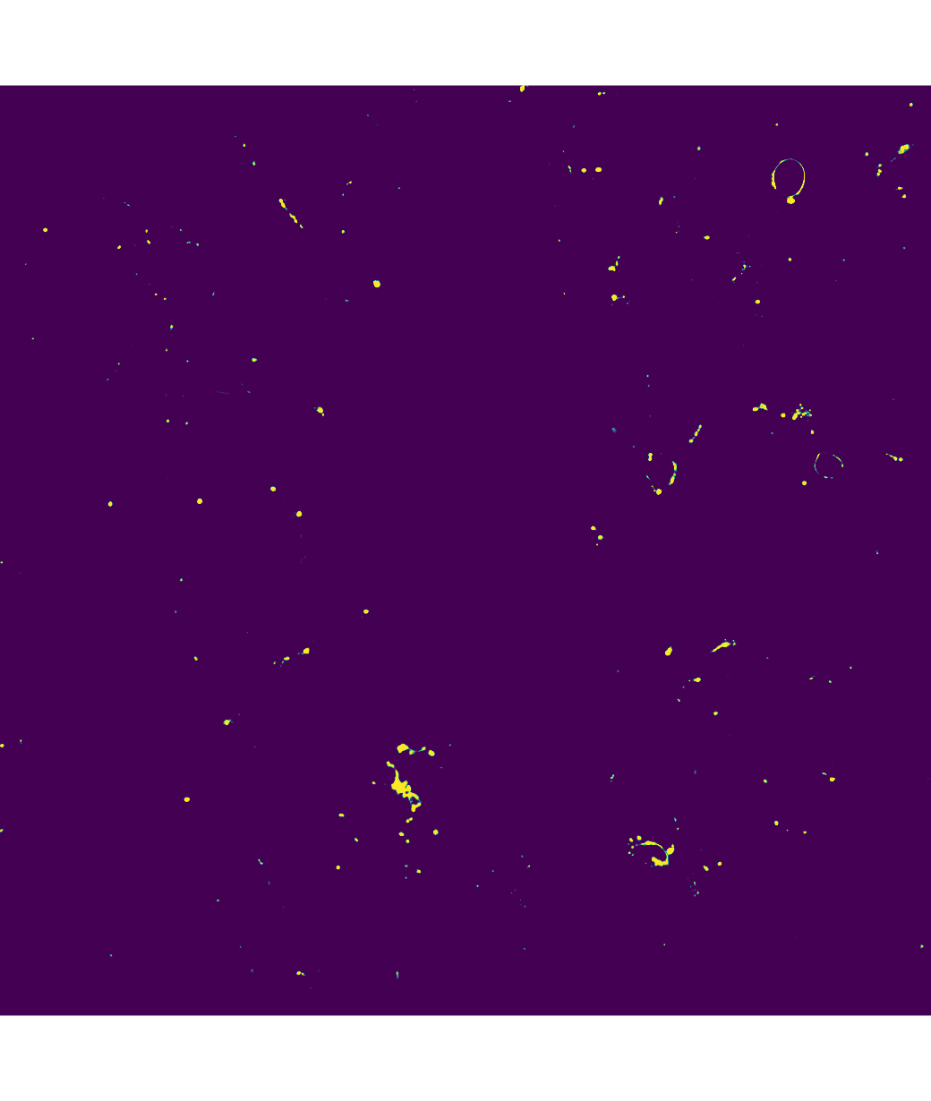
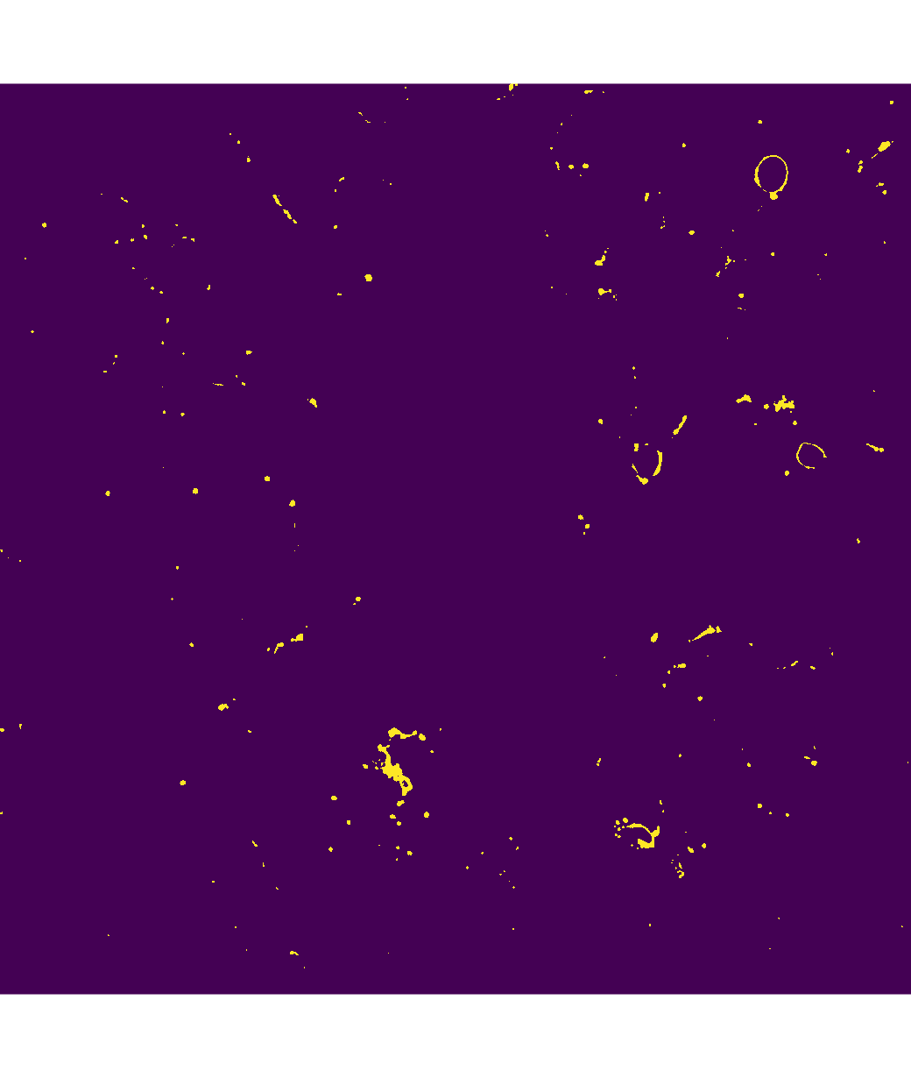
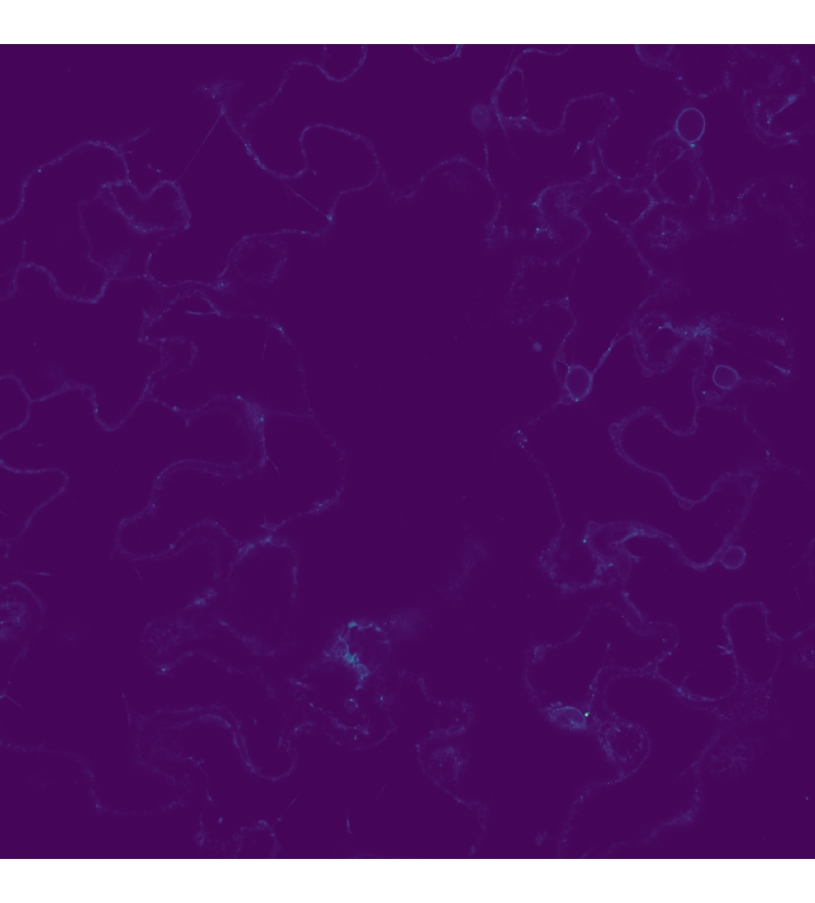
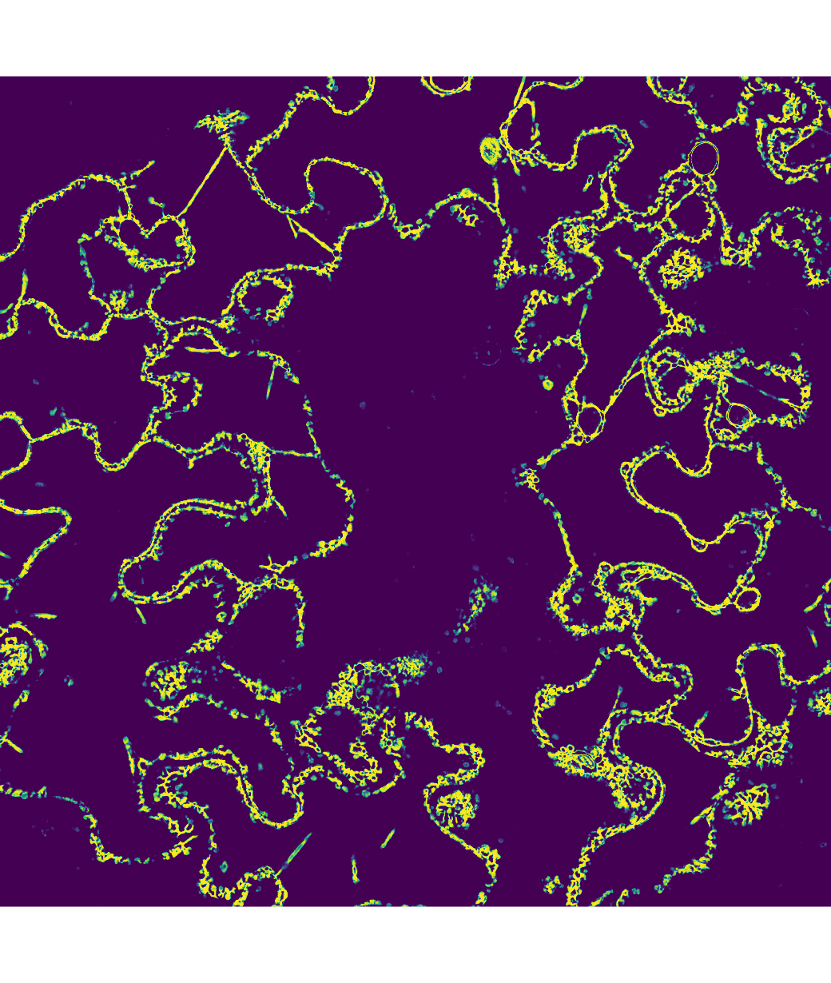
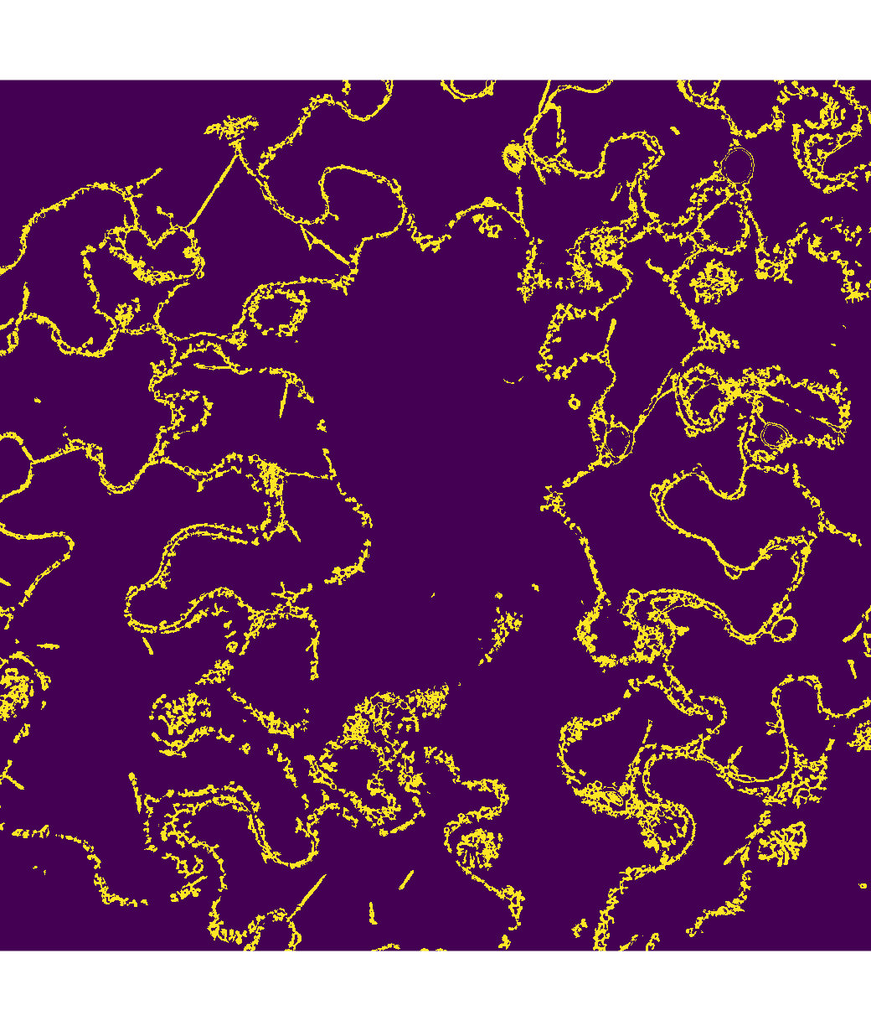
Characterization of 3D organelle motion using curve fitting and clustering by unsupervised machine learning
  Input
  Prediction
  Ground Truth

Slide 18
Novel Transformer based methods for Automatic Classification and Quantification of Stromule Dynamics from Microscopy Images
  3D Unet for Multi-class Plant Cell Organelle Segmentation
 | Dice score on Mitochondria | Dice score on Chloroplast | Dice Score on Cyto-Skeleton | Dice score on ER | Dice score on Puncta
3D Unet | 85.33 | 75.28 | 84.93 | 81.79 | 76.35

Slide 19
Characterization of 3D organelle motion using curve fitting and clustering by unsupervised machine learning
Timeframe
  Start date: May 17, 2024
  End date: December 11, 2024

Slide 20
Characterization of 3D organelle motion using curve fitting and clustering by unsupervised machine learning
What we accomplished
  Milestone 1:
    Learn the curve fitting based algorithm for modeling deformable objects.
    Apply the curve fitting algorithm to obtain stromule motion data from microscopy imagery.
  Milestone 2:
    Learn the basics of unsupervised machine learning methods such as K-Means, and DBSCAN.
    Further analyze the stromule motion data using the clustering method.
  Milestone 3:
    Train the 3D UNet for segmentation of 3D microscopy images.
    Add new functions to our deep learning-based microscopy image processing pipeline.

Slide 21
Characterization of 3D organelle motion using curve fitting and clustering by unsupervised machine learning
Lessons Learned
  Learn the knowledge of different clustering methods for data analysis.
  Train a 3D UNet to perform 3D segmentation of microscopy images.
  Extend and add new functions to the current image processing pipeline.
  Facilitate research with machine learning methods and HPC resources.

Slide 22
Thank you!

