Slide 1
Waveform Systematics for
Black Hole Binary Mergers Models
Student: Samuel Clyne, University of Rhode Island
Samuel.Clyne@uri.edu
Mentor: Dr Michael Puerrer, URI
mpuerrer@uri.edu
Date July 10 2024

Slide 2
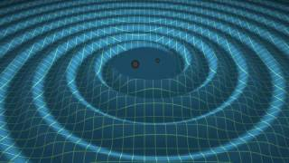
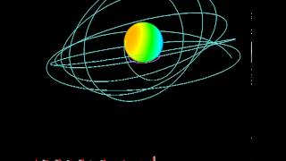
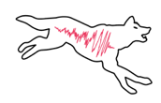
Waveform Systematics for
Black Hole Binary Mergers Models
Background
Gravitational Waves are radiation of energy when massive objects collide
Thanks to general relativity, we can construct synthetic waveforms to compare detection date to
Different waveform model families have different underlying physics
Previous work analyzed simple waveform models, current project focuses on full waveform model
https://www.youtube.com/watch?v=zLAmF0H-FTM&t=4s
https://www.youtube.com/watch?v=grA5KfDlsAY&t=1s
Code: https://github.com/dingo-gw/dingo

Slide 3
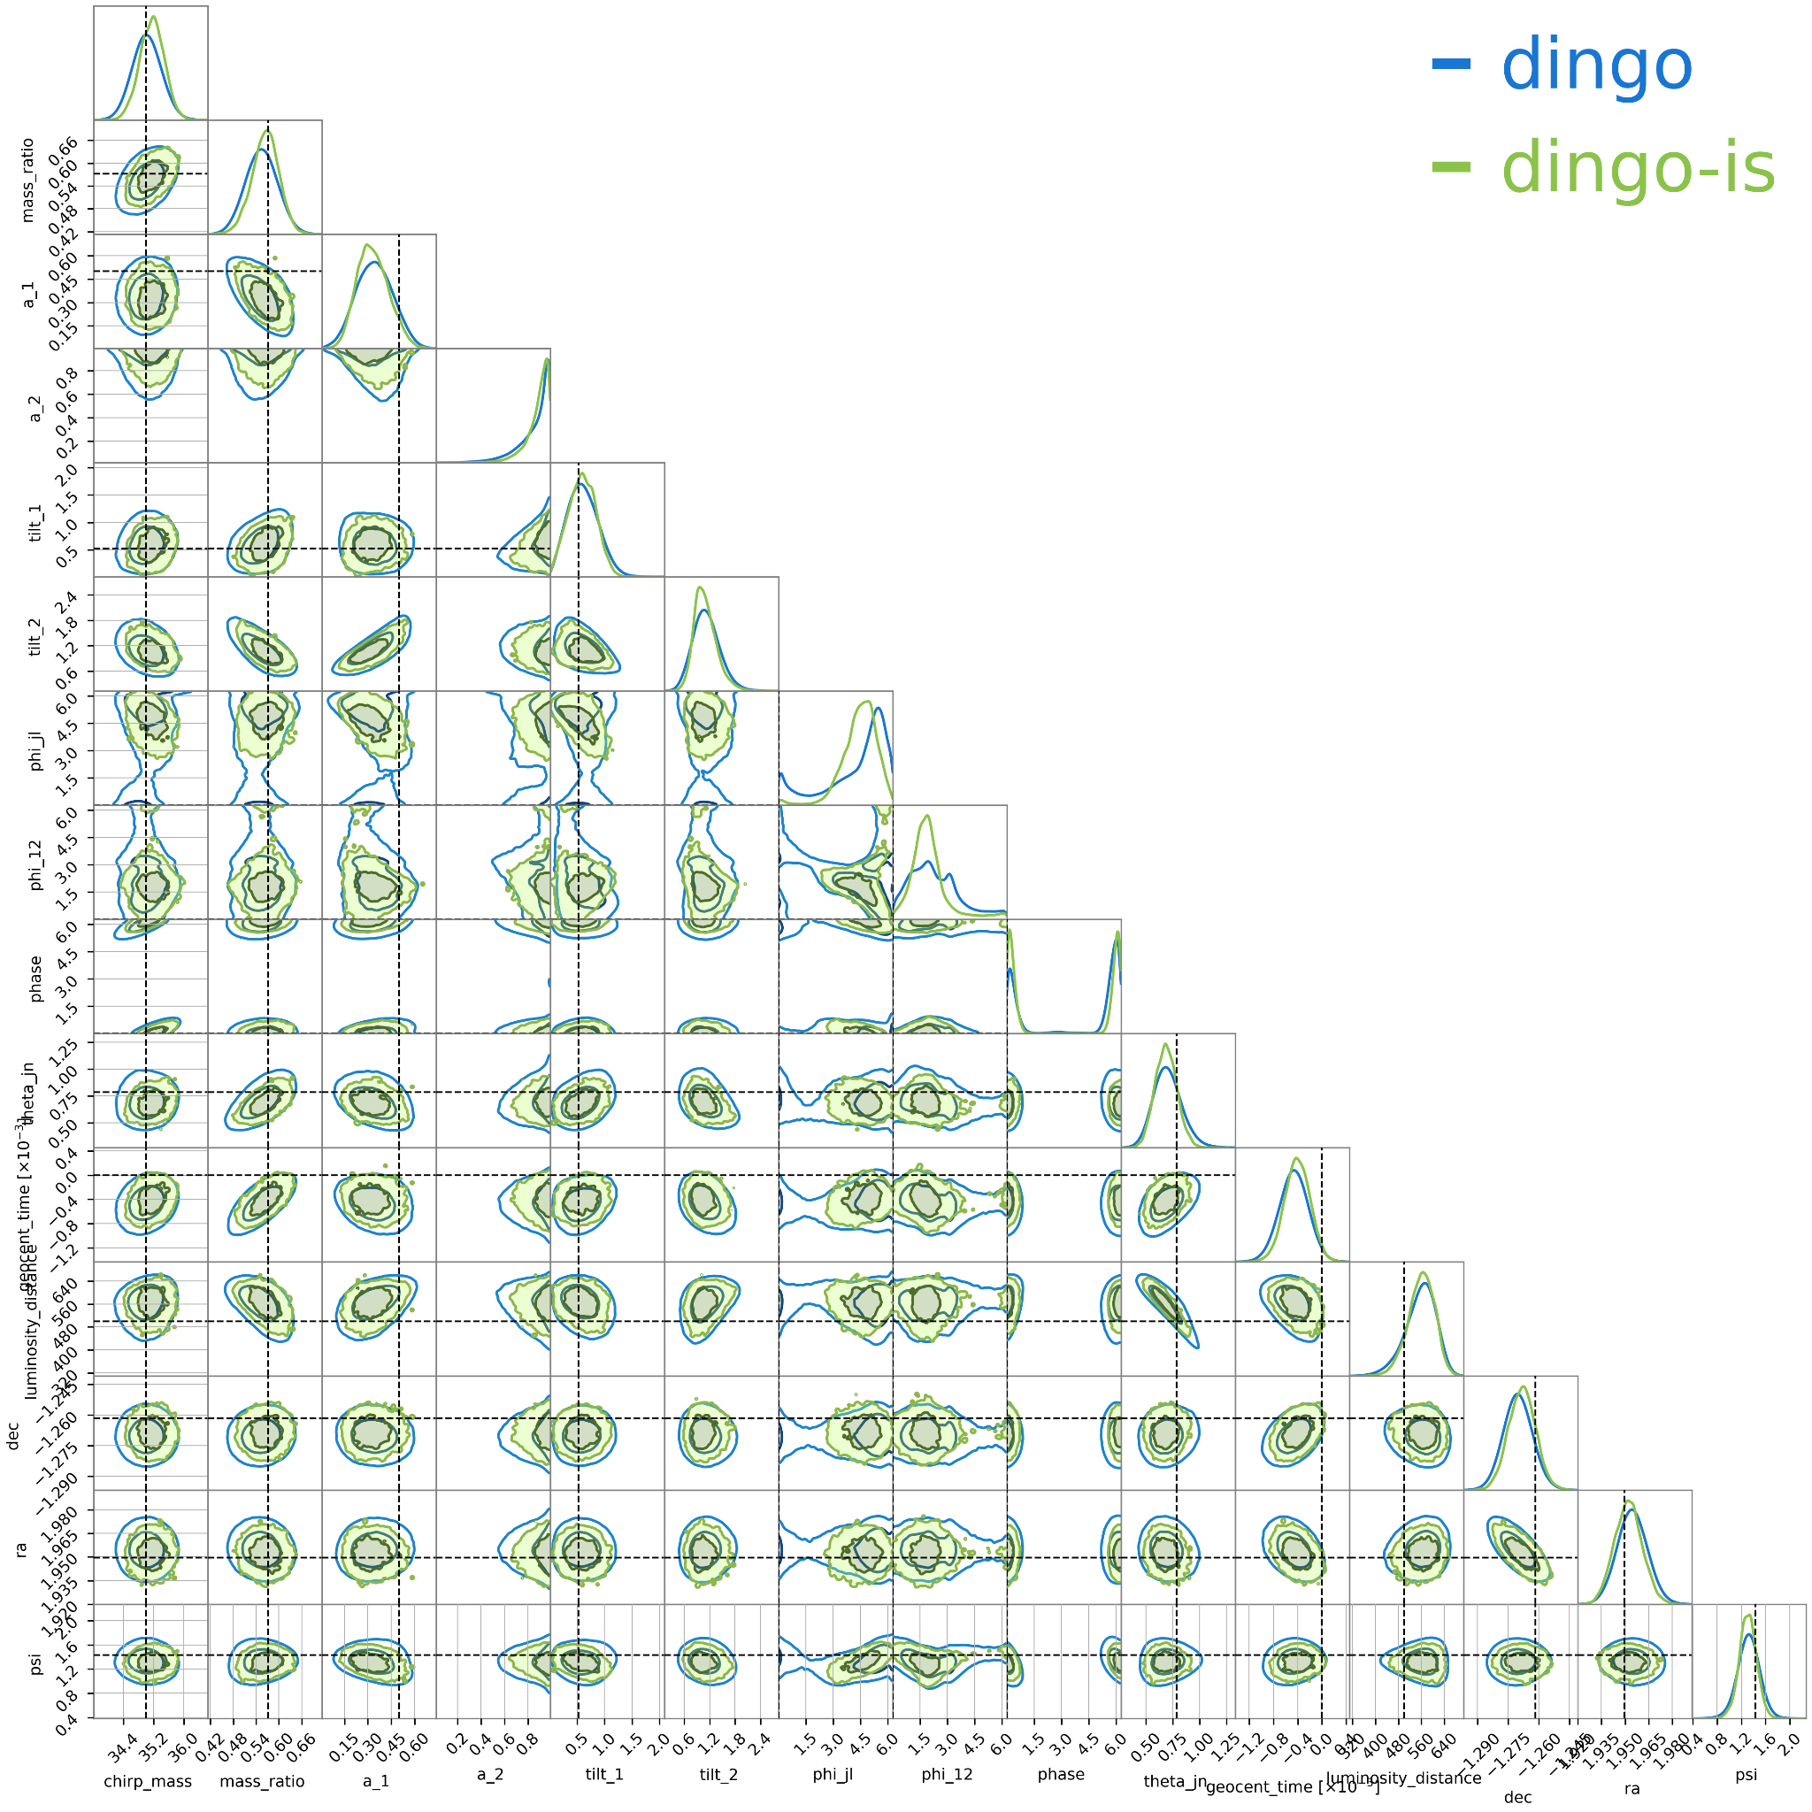
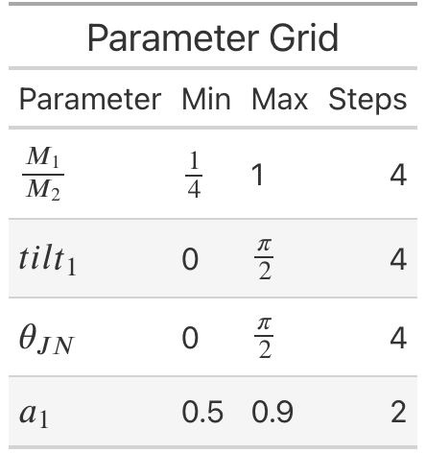
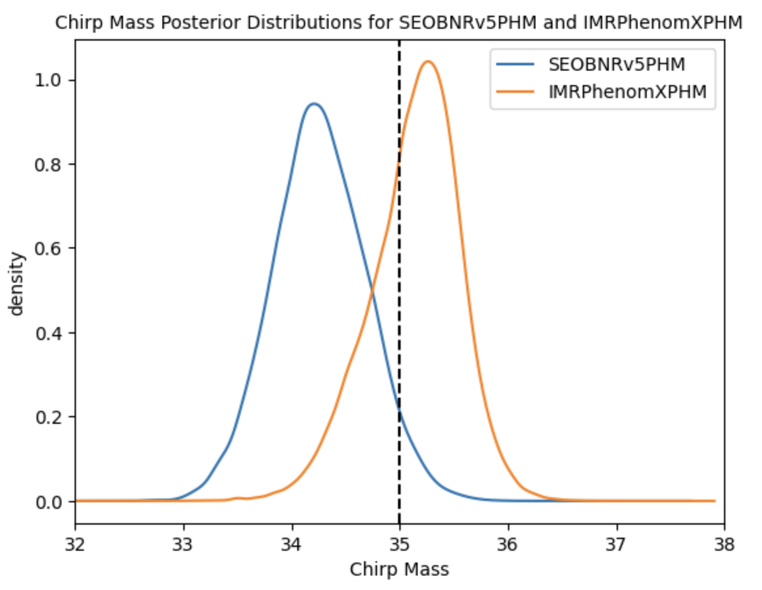
Waveform Systematics for
Black Hole Binary Mergers Models
Goals
Leverage Deep Inference for Gravitational Wave Observations (DINGO) neural networks to analyze injections with models trained on different waveform families
Compare posterior results across a grid varying mass ratio, tilt, theta_JN, and a_1 to map systematic bias
Code: https://github.com/dingo-gw/dingo

Slide 4
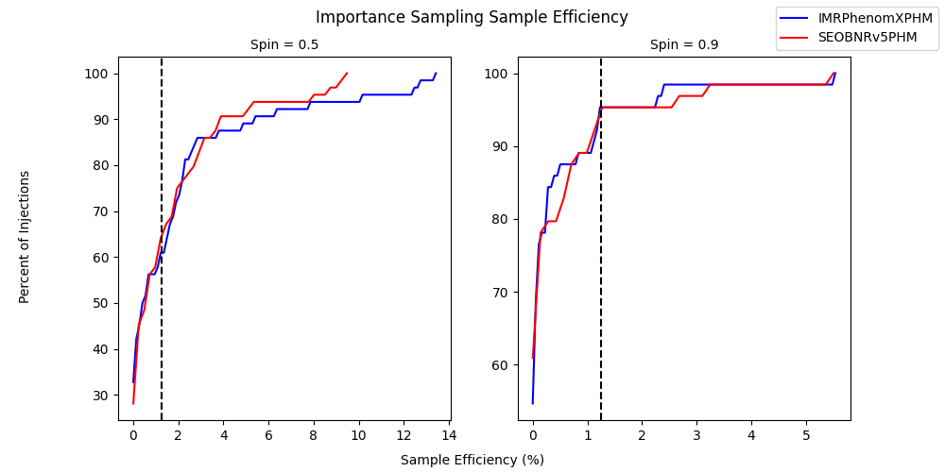
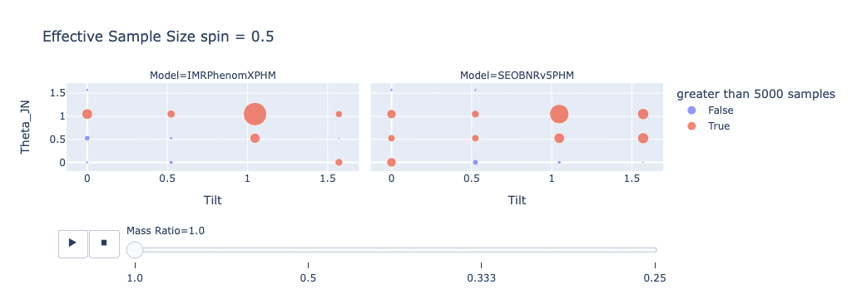
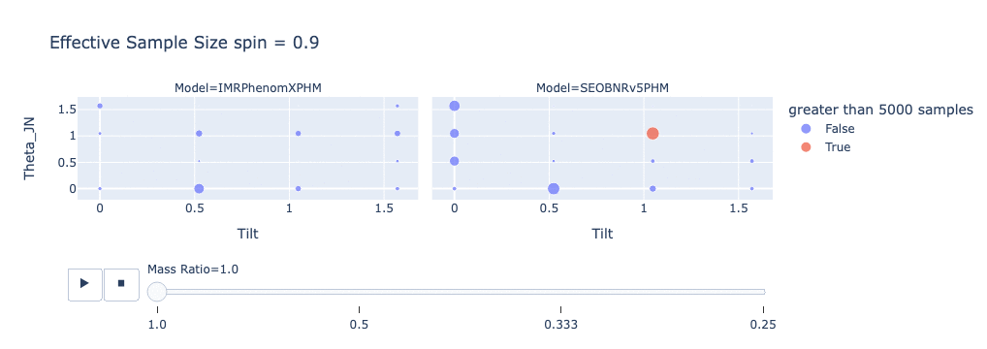
Waveform Systematics for
Black Hole Binary Mergers Models
Importance Sampling
Assigns a weight to each sample generated by DINGO
Weighted distribution shifts DINGO results towards true posterior distribution
Effective sample size generated based on variance of weights

Slide 5
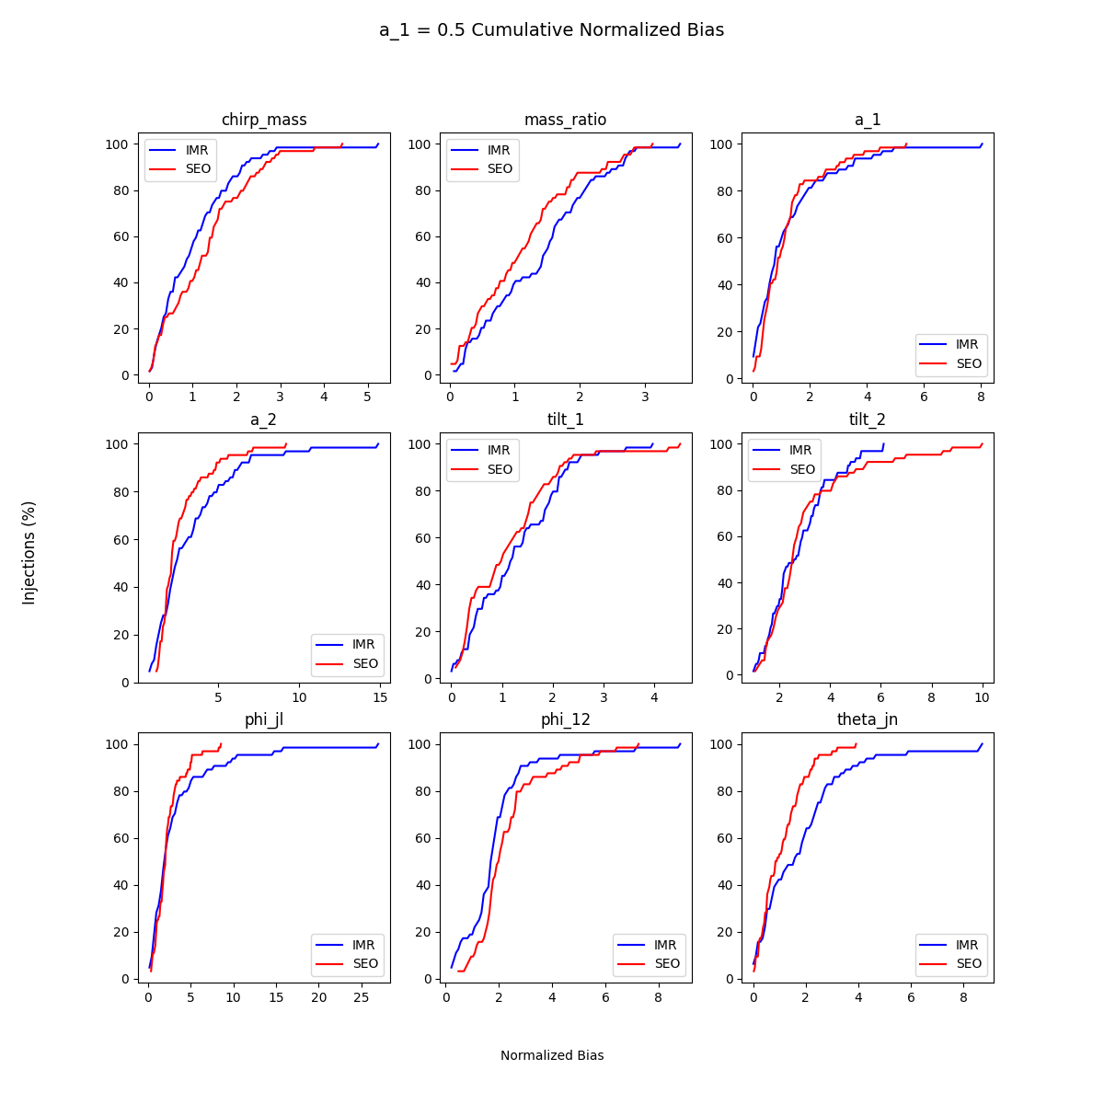
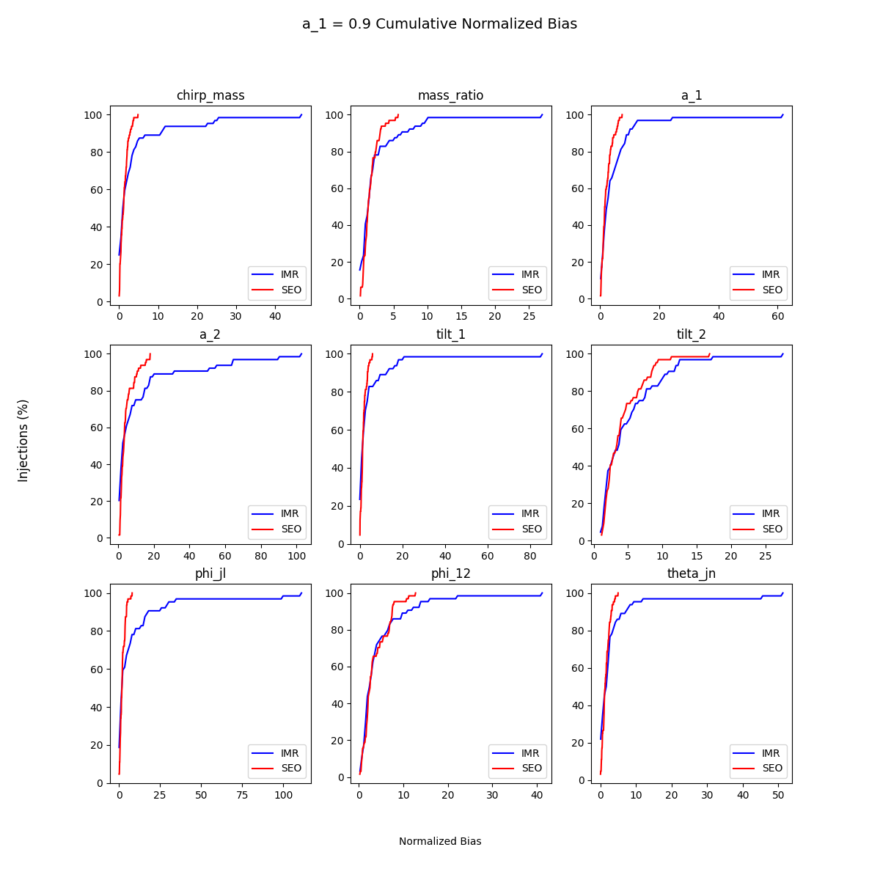
Waveform Systematics for
Black Hole Binary Mergers Models
Normalized Bias
Similar Bias in spin ½ injections.
Large outliers in spin 0.9 injections
Outliers occur with high tilt and low mass ratio

Slide 6
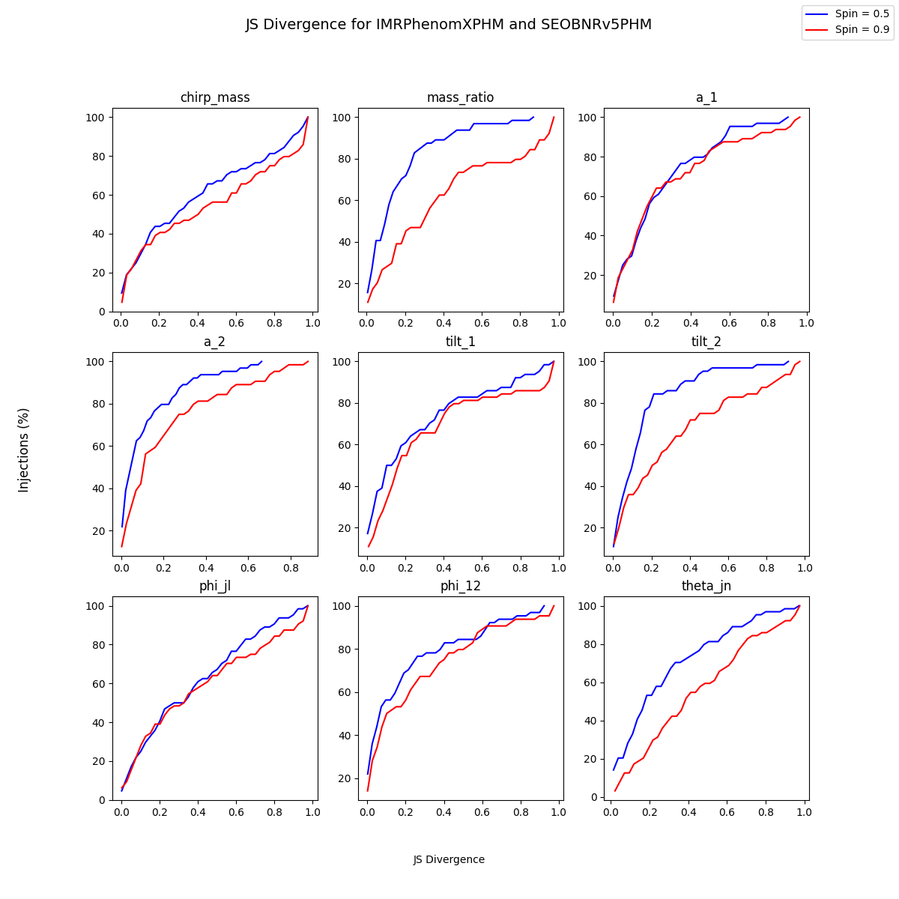


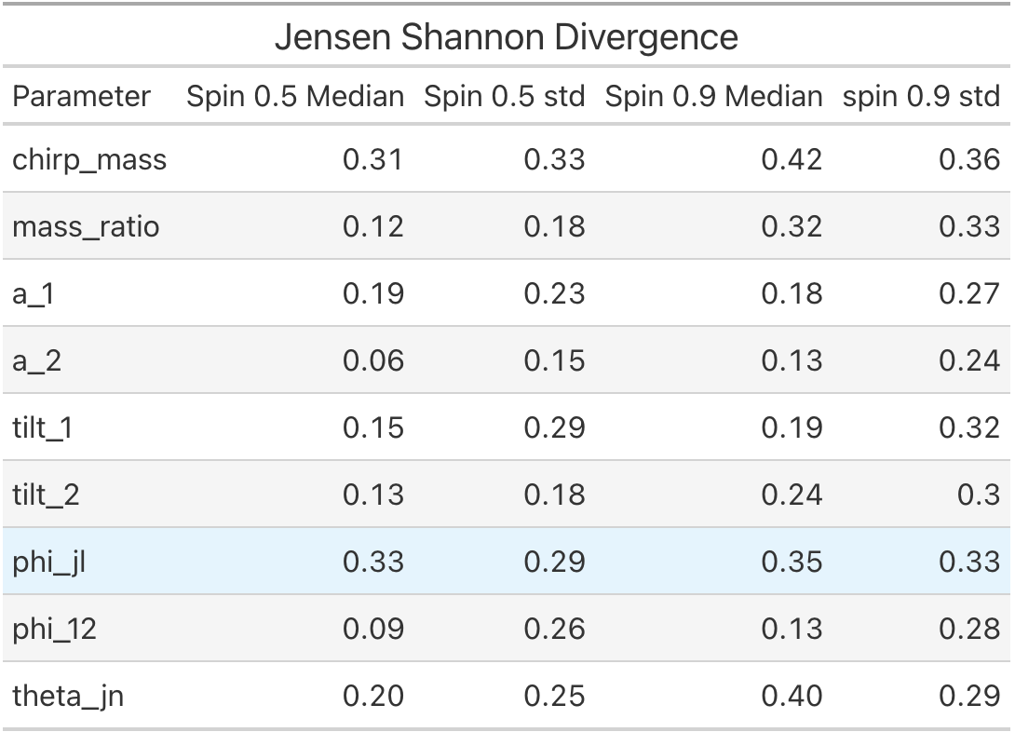
Waveform Systematics for
Black Hole Binary Mergers Models
Used Jensen Shannon divergence to compare models
Moderate JS-Divergence value, suggesting similar posteriors
  indistinguishability threshold of 0.002

Slide 7
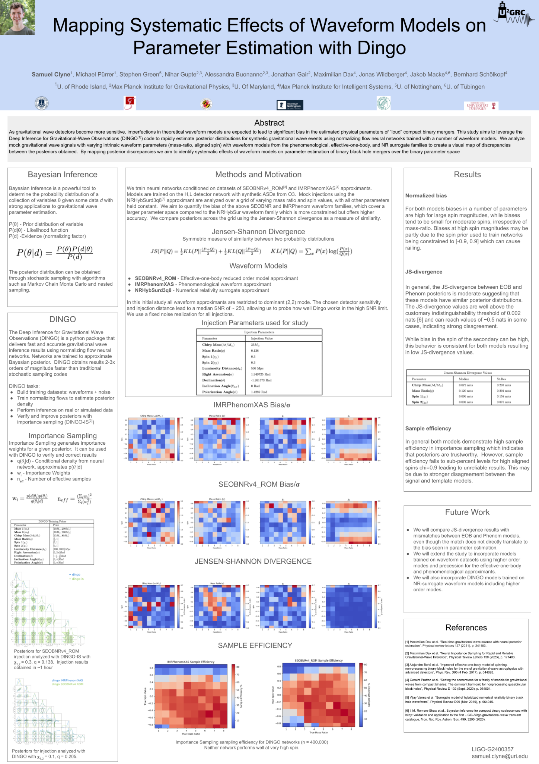
Publications/Contributions
Poster presentation at LIGO-VIRGO-KAGRA March Meeting in Baton Rouge, LA
URI AI Lab Poster Competition
Paper expected in future

Slide 8
Challenges
Difficult to Interpret data when varying 4 parameters
Low sample efficiency at high spins limit the scope of study

Slide 9
Lessons Learned
Theoretical impact of different parameter values on gravitational wave signal
An understanding of gravitational wave waveform models
3d visualization tools (plotly)

