Slide 1
Multimodal Analysis of Mental Health Rhetoric on TikTok
Student: Nathaniel Nichols, University of Rhode Island,
nnichols@uri.edu
Mentor: Ammina Kothari, University of Rhode Island,
akothari@uri.edu
Date: 07/10/2024

Slide 2
Multimodal Analysis of Mental Health Rhetoric on TikTok
Prolonged time spent on social media has been associated with increased risks of mental health difficulties, including depression, inattention, conduct problems, loneliness and other risky behaviors, and fear of missing out (Barry et al., 2017; Brunborg & Andreas, 2019; Oberst et al., 2017; Odgers & Jensen, 2020; Vannucci et al.,2020; Zenone & Barbic, 2021). However, social media has also been identified as a resource for mental health support, as well as cultural activism (Naslund et al., 2020; Power et al., 2020; Divon & Ebbrecht-Hartmann, 2022). A growing number of licensed therapists and mental health professionals identified as mental health influencers (MHI) share content focusing on psychoeducation and anecdotes from their professional and lived experiences (Triplett et al., 2022) on TikTok. Our project explores the mental health discourse on TikTok in three languages - English, Portuguese, and Arabic by MHIs to examine linguistic and visual differences in how mental health-related topics are presented by expert and regular influencers. The multimodal comparative analysis examines how these accounts use video, text, images, and sound to discuss mental health-related information in three languages (Arabic, English, and Portuguese) that resonate with their audience.

Slide 3
Goals
Identify the dominant mental health-related topics on TikTok in the three countries (United States, Brazil, and Egypt).
Determine if there are differences in mental health information by language or culture and whether the accounts contributed to mental health literacy.
Test the efficacy of using computational tools to conduct multi-modal analysis on TikTok.

Slide 4
Multimodal Analysis of Mental Health Rhetoric on TikTok
Timeframe
  Start date: January 9
  End date: July 10

Slide 5
What we accomplished
Collected various data about each video, including spoken audio, on-screen text, captions, dominant color, facial presence, emotional sentiment, and duration
Used parallel computing to speed up the process of data collection
Constructed an LDA topic model of the video and audio text, grouped by country

Slide 6
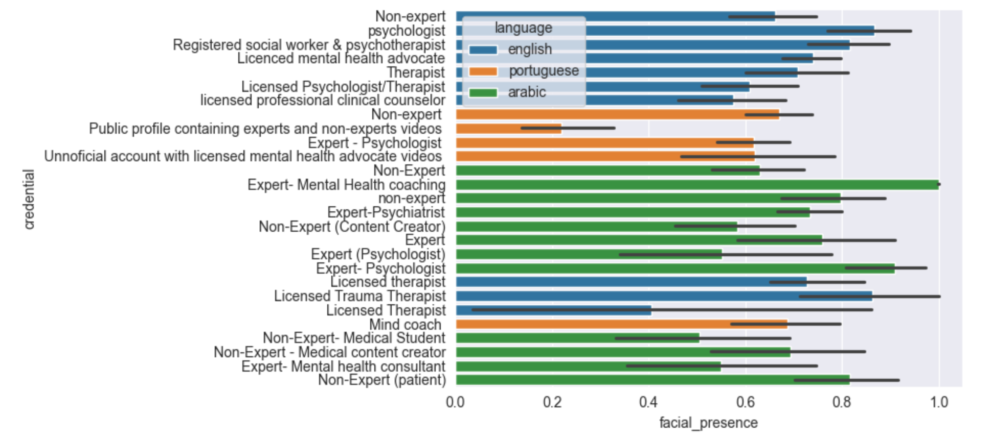
What we accomplished

Slide 7
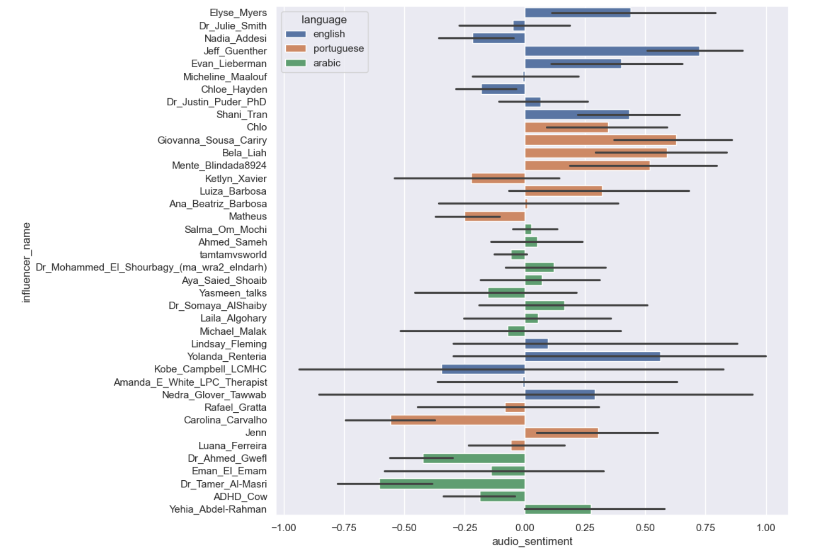
What we accomplished

Slide 8
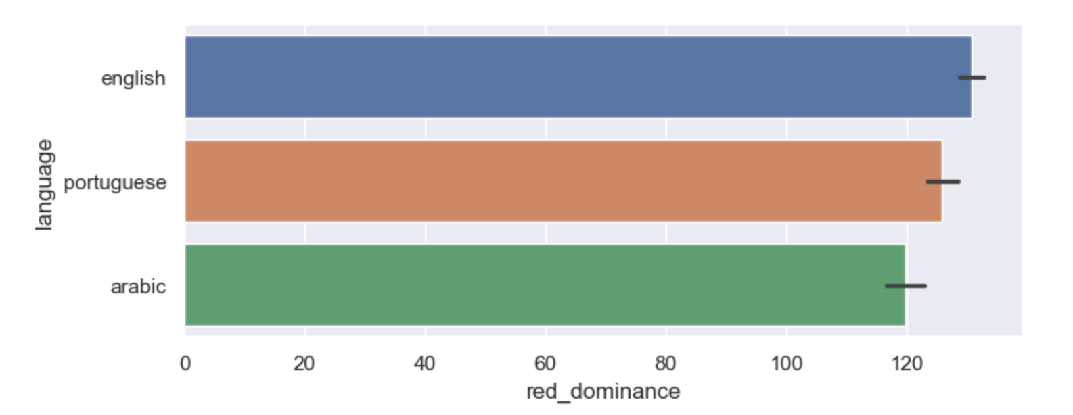
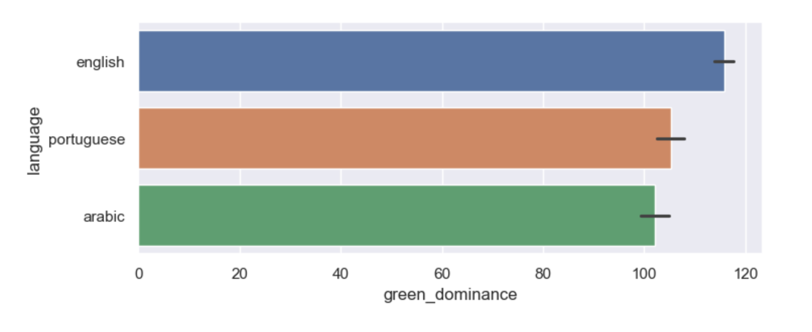
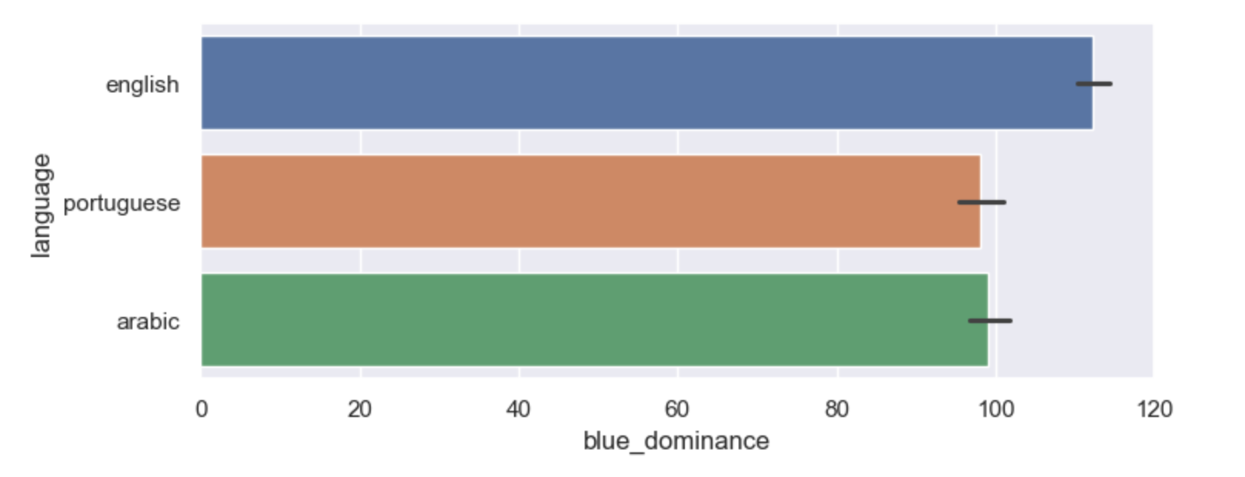
What we accomplished

Slide 9
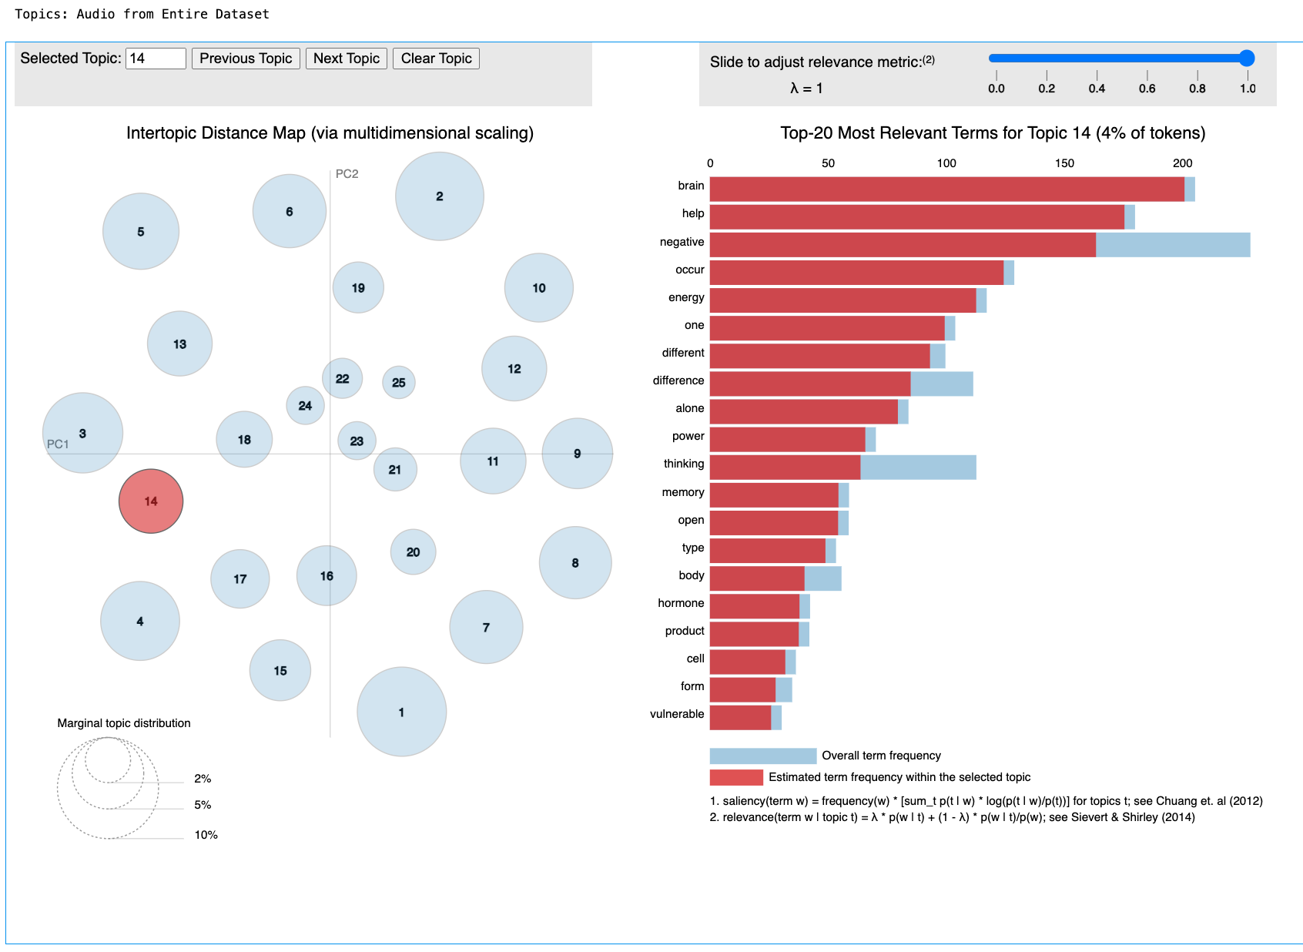
What we accomplished

Slide 10
Lessons Learned
What went well? What could we have done differently?
  OpenCV’s tools for facial detection and color dominance calculation are well developed, accurate, and fairly easy to use with a bit of research.
  Voice capture not perfect, but pretty good overall, and easy to use
  Translations needed some corrections, but were overall pretty usable.
  OCR (Optical Character Recognition) was less accurate than it would have ideally been, since it picked up a lot of noise in the background.
  Parallel computing using Unity cluster encountered several errors that required quick solving (couldn’t use a translation API on the cluster), and was still a bit slower than would have been preferred.

Slide 11
Publications/Contributions
Paper to be completed by Ammina Kothari, Rana Hassan, and Alejandra Josiowicz in the near future

Slide 12
Acknowledgements
Rana Hassan and Alejandra Josiowicz (co-researchers)

