Slide 1
Investigation of Heat Transfer in Complex Materials using Molecular Dynamics Simulations
Student: Jaymes Dionne, University of Rhode Island
diojaymes@uri.edu
Mentor: Dr. Ashutosh Giri, University of Rhode Island
ashgiri@uri.edu
5/17/24

Slide 2
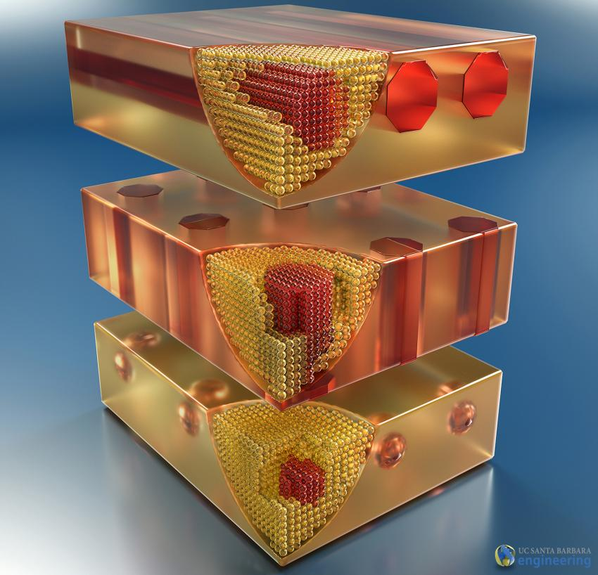
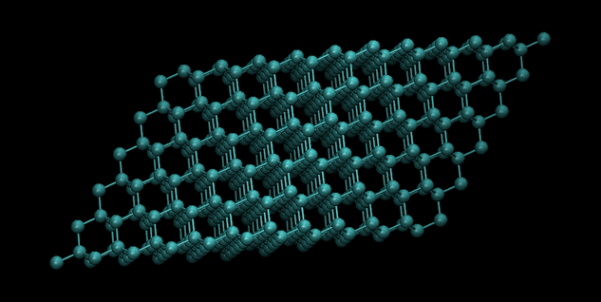
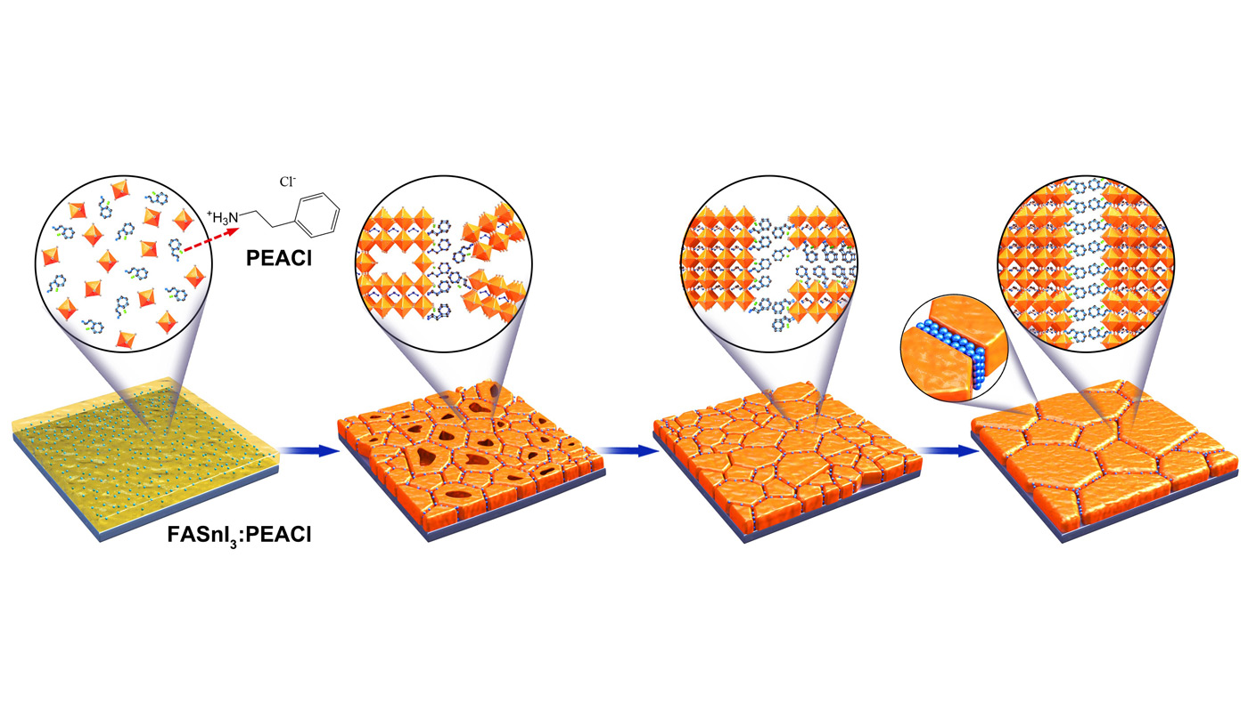
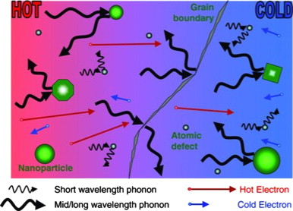



Investigation of Heat Transfer in Complex Materials using Molecular Dynamics Simulations
L
HEAT
$$Q=−κ\frac{dT}{dx}$$
$$κ={Cvλ}/3$$
$$κ={Cvλ}/3$$

Slide 3
Investigation of Heat Transfer in Complex Materials using Molecular Dynamics Simulations
Goals
  Determine unique phonon scattering mechanisms for materials with closely-packed internal boundaries
  Determine applicability of “toy-box” models to complex systems
  Determine ideal “packing” behaviors to tune thermal transport

Slide 4
Investigation of Heat Transfer in Complex Materials using Molecular Dynamics Simulations
Timeframe
  Start: 11/1/2023
  End: 4/30/2024

Slide 5
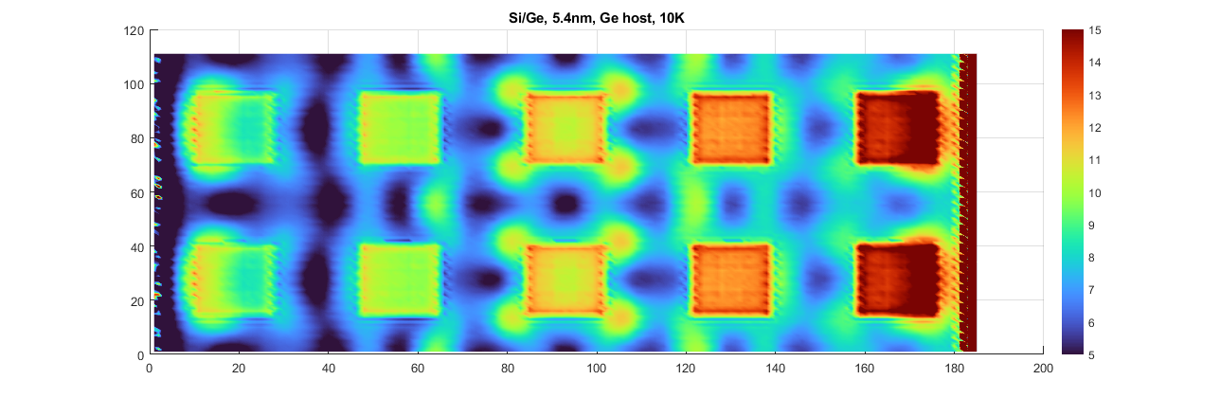
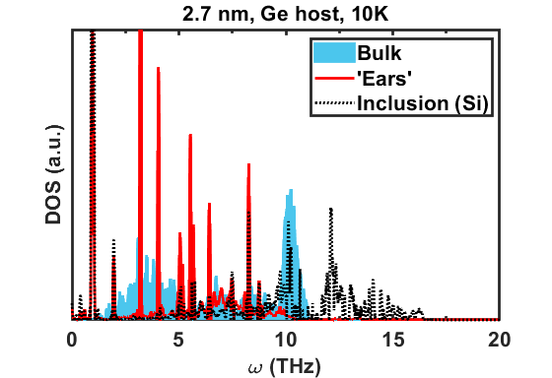
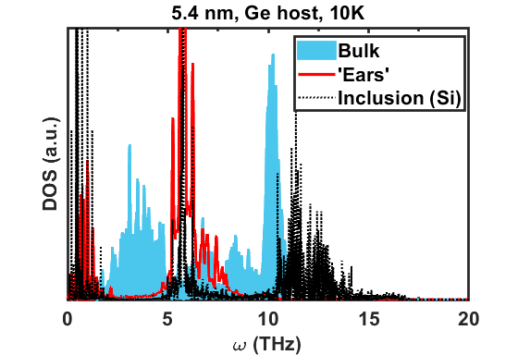
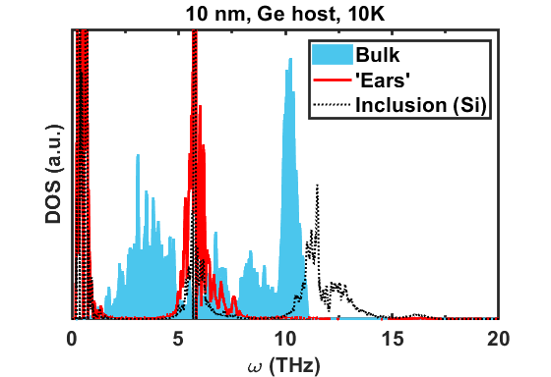

Slide 6
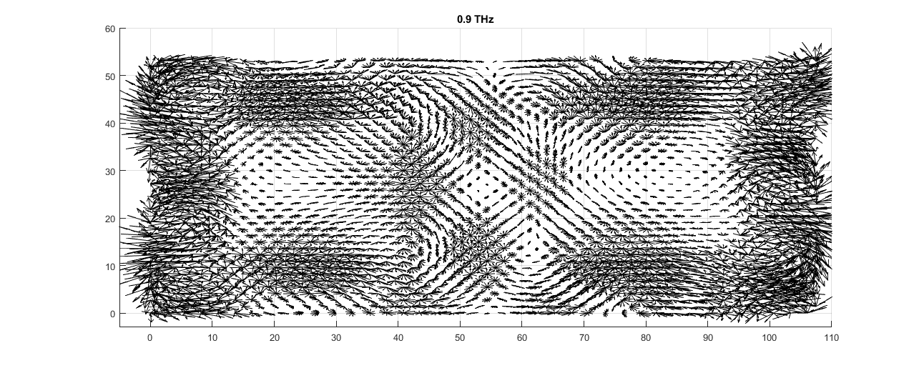
Low frequency, extended modes within the host couple with modes in the inclusion.

Slide 7
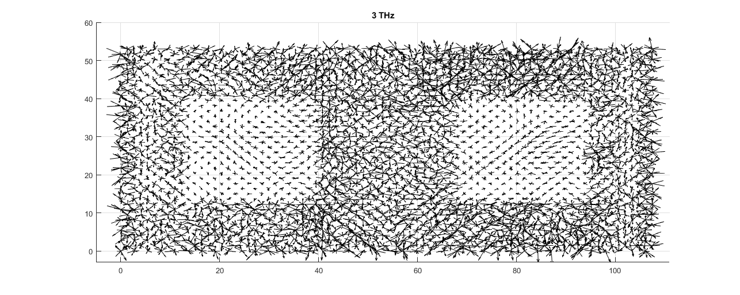
Vibrational “deadzones” exist within the inclusion (and possibly the host)

Slide 8
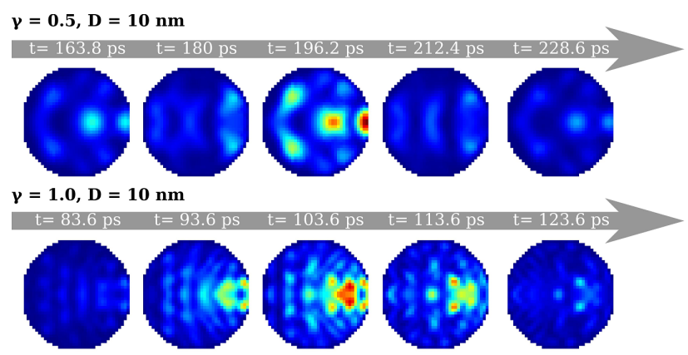

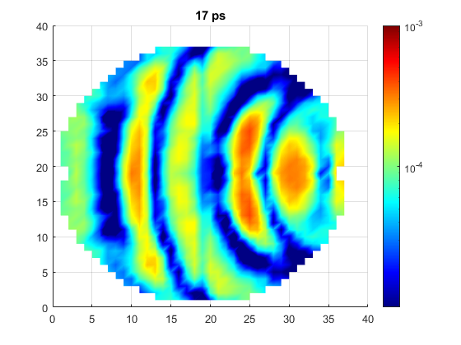
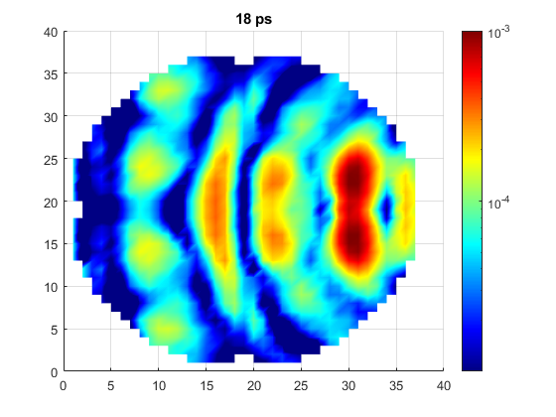
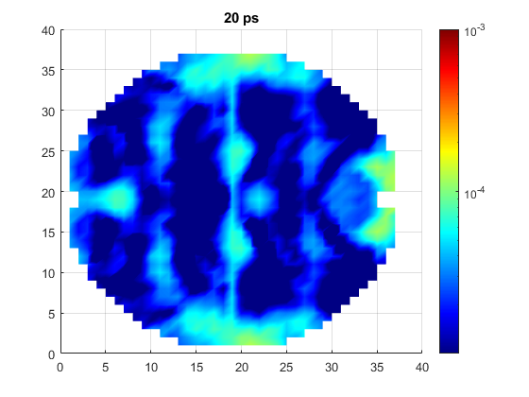

Slide 9
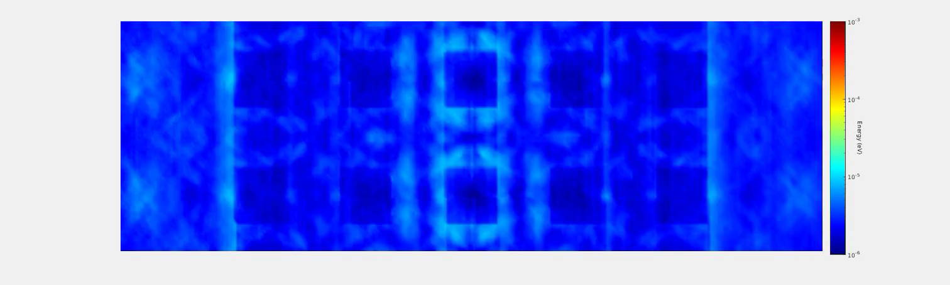
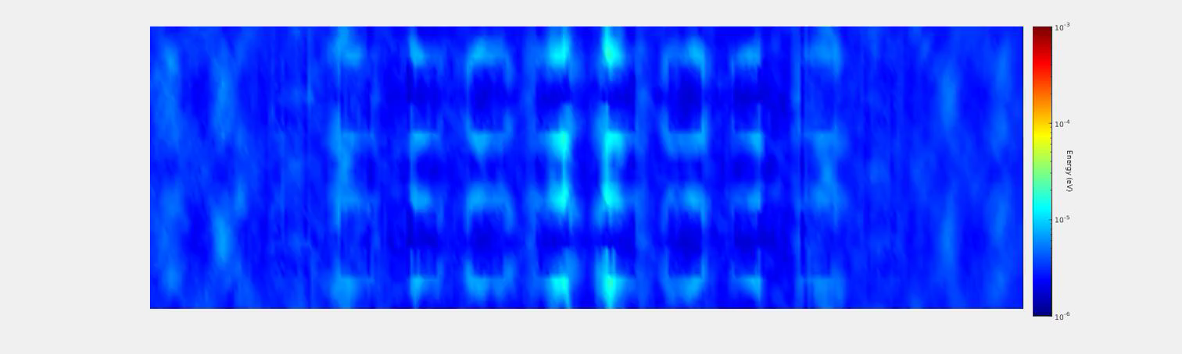
Γ = 1.5 (Rayleigh – Mie)
D = 5.4 nm
Γ = 1.0 (Rayleigh)
D = 2.7 nm

Slide 10
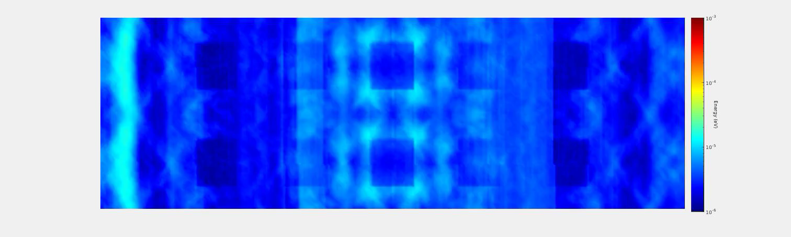
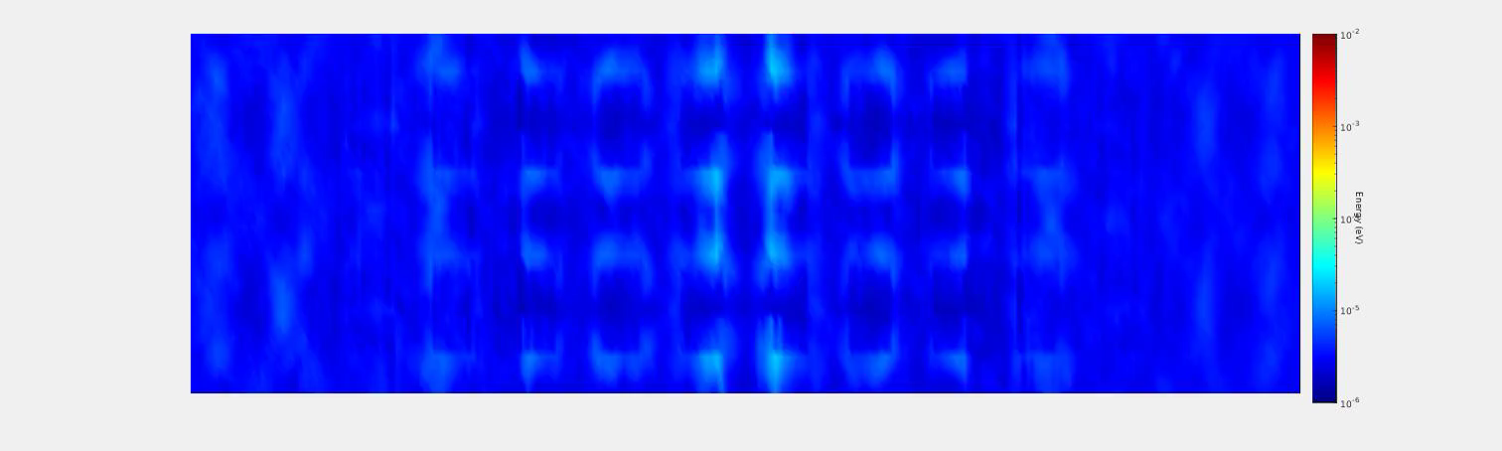
Γ = 4 (Mie)
D = 5.4 nm
Γ = 2.0 (Mie)
D = 2.7 nm

Slide 11
Lessons Learned
Visualization is important!
  2D visualization allows us to view how our waves interact in our system
  But… requires huge data files (~300-500 Gb), and long simulation/analysis times (1-2 weeks from start to finish
Still need to unify various results
Changes in the future:
  Utilize job arrays
  Utilize Python to better link w/ LAMMPS, enable high-throughput simulations

Slide 12
Publications/Contributions
“Wave Hopping in the Mie Regime”
  Paper in the works; still need more data and evidence from alternative methods
Eigenvector analysis, wave generation, and wave visualization codes being uploaded to GitHub

