Slide 1
HOST-SYMBIONT
POPULATION GENOMICS
Intraspecific variability
in methanogenic symbionts
of marine anaerobic ciliates
Facilitator: JOHANA ROTTEROVA, University of Rhode Island
jrotterova@uri.edu
Mentor: CORINNA BREUSING, University of Rhode Island
Researcher: ROXANNE BEINART, University of Rhode Island
11/09/2022

Slide 2
CILIATE symbioses
Important aid in anoxia
Archaeal methanogens
Bacterial sulfate reducers
Bacterial denitrifiers
Digestion resistant bacteria and others with unknown function
Rotterova et al. 2022
Rotterova et al. 2022

Slide 3
What does the host specificity look like?
Is there intraspecific variability?
Are the symbionts transmitted exclusively vertically?
Have there been horizontal transmission events?

Slide 4
Goals
Phylogenetic analysis to map the population specific diversity of the host and symbionts
De novo host transcriptome assembly
Genomic analysis and genetic variability of symbionts within one ciliate host
Timeframe – January 2022 – June 2022 (and ongoing)

Slide 5
Diverse symbiotic intracellular archaea
16S rDNA symbiont (left) and 18S rDNA host (right) phylogenetic tree
Rotterova et al. 2022

Slide 6
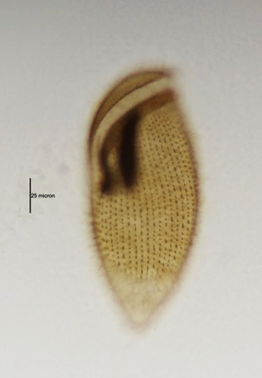
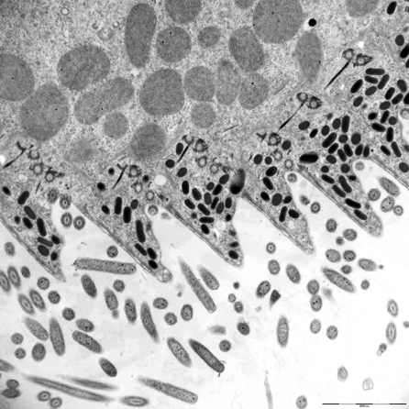
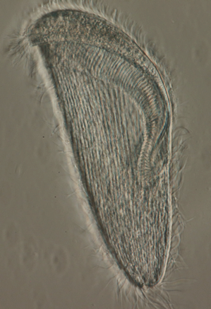
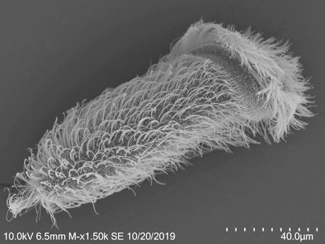
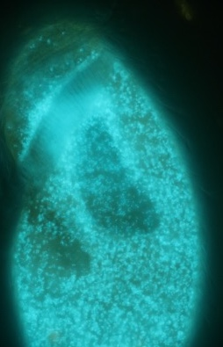
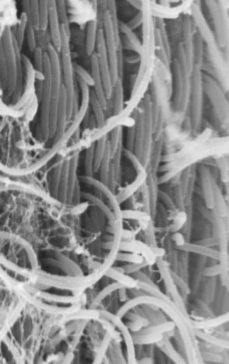
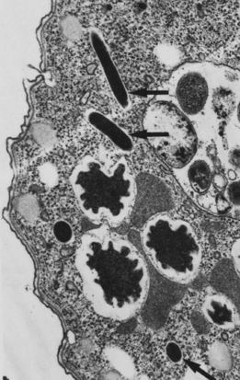
‘Hirsometopus’ and its symbionts
Marine anaerobic ciliate with a reduced mitochondrial genome
Endosymbiotic intracellular archaeon Methanocorpusculum and bacterial ectosymbionts
Metopus contortus, TEM
Lewis et al 2020
Trimyema finlayi, TEM
Finlay et al 1993

Slide 7
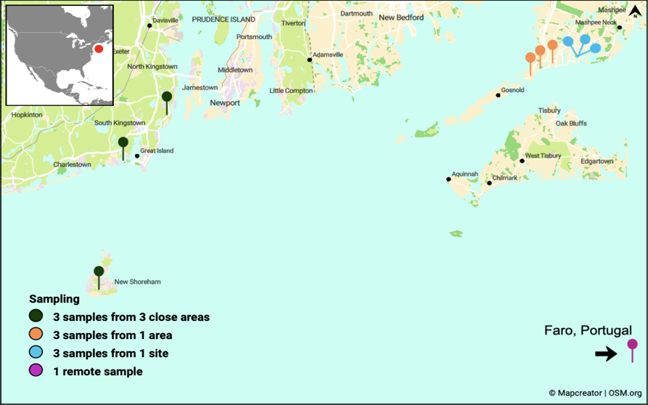
‘Hirsometopus’ populations in New England
10 NE cultivated populations
  Block Island, RI – BI27A
  Black Point, RI – BLAMEL4B
  Matunuck, RI – M4C
  Salt Pond, MA – SALT210, S16B, S15A
  Fresh River, MA – F22, F24, F26, F25B
1 cultivated population from Europe
  Faro, Portugal - FARO3
1 uncultivated population from a fresh sample
  Point Judith Pond, RI, USA – JUMA2M
1 unrelated uncultivated ciliate population for control – Plagiopyla sp.
  Point Judith Pond, RI, USA – JUMA2P

Slide 8
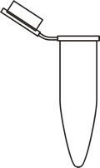

Methods
Sampling
Over 100 sediment samples
Cultivation
Over 10 ‘Hirsometopus’ populations
Mass culture preparation
1 population
~ 10 000 cells
Cell picking
5-8 starved washed cells from each population
Whole genome Amplification
WGA – RepliG Single Cell
18S & 16S screening
30 starved cells of each population
DNA amplification, purification
Sanger rDNA sequencing
Transcriptome Sequencing
Illumina Nova Seq Platform Plexwell LP384
1 RNA sample
Genome Sequencing
Illumina Nova Seq Platform Plexwell LP384
78 SC DNA samples (5 excluded)
Bioinformatic Analysis
Notes:
in contrast to PCR-based methods, Phi 29 polymerase has a 3’-5' exonuclease proofreading activity to maintain 1000-fold higher fidelity than Taq Polymerase during replication
used in the presence of exonuclease-resistant primers to achieve high yields of DNA product from all kinds of mammalian and bacterial tissues

Slide 9
Bioinformatic Analysis
Andromeda Cluster, URI
Read Cleaning, Trimming, Filtering
78 DNA samples
1 RNA sample
MAG Assembly
78 DNA samples
Transcriptome Assembly
1 RNA sample
Symbiont Binning
78 DNA samples
Symbiont bin classification
78 DNA samples
Reconstructing MRO genomes
78 DNA samples
ORF prediction
1 RNA sample
Genetic variation
78 DNA samples
Annotation, gene selection, alignment, concatenation
78 DNA samples
Completeness evaluation
1 RNA sample
Phylogeny
78 DNA samples
1 RNA sample
Sanger sequencing samples
Dataset, alignment
Sanger sequencing samples
Notes:
in contrast to PCR-based methods, Phi 29 polymerase has a 3’-5' exonuclease proofreading activity to maintain 1000-fold higher fidelity than Taq Polymerase during replication
used in the presence of exonuclease-resistant primers to achieve high yields of DNA product from all kinds of mammalian and bacterial tissues

Slide 10
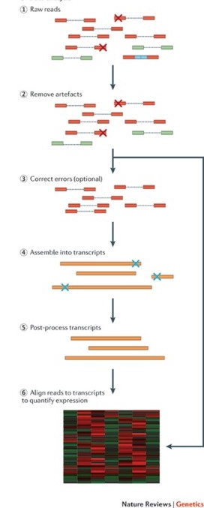
Transcriptome Pipeline
Initial quality check FASTQC
Adaptor trimming TRIMMOMATIC
1 RNA sample
Contaminant removal SAMTOOLS, BOWTIE2, SEQTK
Removal of rRNA SORTMERNA
Error correction & normalization TRANSCRIPTOMEASSEMBLYTOOLS
Separating host and prokaryotic reads BBSPLIT
Assembly TRINITY (PASAFLY algorithm)
Species clustering of assembled contigs CD-HIT-EST
Prediction of ORFs TRANSDECODER, HMMER, BLASTP
Non-euk/ORF transcript removal BOWTIE2, SAM/BLOBTOOLS, SEQTK
Assembly statistics TRINITY STATS
Quality and completeness evaluation BUSCO
Notes:
in contrast to PCR-based methods, Phi 29 polymerase has a 3’-5' exonuclease proofreading activity to maintain 1000-fold higher fidelity than Taq Polymerase during replication
used in the presence of exonuclease-resistant primers to achieve high yields of DNA product from all kinds of mammalian and bacterial tissues

Slide 11
Transcriptome assembly and optimization
Illumina Seq, length 151 bp, TruSeq stranded mRNA
120 M reads
F25B-A1A10_1_clean.fastq - 12 G
F25B-A1A10.Trinity.merged95.fasta – 63 M
total # of reads evaluated = 32416348 // number of reads retained = 30019930 // number of PE reads filtered = 2396418
30019930 reads; of these: 30019930 (100.00%) were paired; of these:
22690897 (75.59%) aligned concordantly exactly 1 time
4791185 (15.96%) aligned concordantly >1 times
1837825 (72.42%) aligned discordantly 1 time
99.31% overall alignment rate
Predicted proteins in agreement with
other investigated Metopid ciliates
Sample ID | Total read bases (bp) | Total reads | GC(%) | AT(%) | Q20(%) | Q30(%)
F25B-A1A10 | 18,196,928,762 | 120,509,462 | 45.83 | 54.17 | 96.61 | 92.65
Rotterova et al. 2022

Slide 12
Metagenomic Pipeline
Initial quality check FASTQC
Adaptor trimming TRIMMOMATIC
78 DNA samples
Contaminant removal SAMTOOLS, BOWTIE2, SEQTK
MAG assembly METASPADES
Host MRO Genomes
Reconstruction MITOBIM, NOVOPLASTY, BLAST
Annotation MFANNOT
Alignment MAFFT
Multigene phylogenetic analysis IQTREE, RAXML
Prokaryotic Binning METABAT, MAXBIN, DAS_TOOL, METAWRAP
Completeness control CHECKM
Taxonomic classification of bins GTDBTk
Phylogenetic analysis GTDBTk, RAXML
Genetic variation PANPHLAN
Notes:
in contrast to PCR-based methods, Phi 29 polymerase has a 3’-5' exonuclease proofreading activity to maintain 1000-fold higher fidelity than Taq Polymerase during replication
used in the presence of exonuclease-resistant primers to achieve high yields of DNA product from all kinds of mammalian and bacterial tissues

Slide 13
Ciliate MRO genomes
MT - Uniparental inheritance, faster evolution
In anaerobes - reduced genome
Anaerobic ciliates – Ribosomal genes; Complex I
Linear DNA
Selected one sample per each population
Two contigs (as in Metopus contortus Lewis et al. 2020)
No MRO genome in Plagiopyla - ?
Lewis et al. 2020
Rotterova et al. 2020

Slide 14
Genes encoded in ‘Hirsometopus’ MRO genome
Genetic code – 4; 14 – 30 genes/orfs per contig
F25B | nad1 |  |  | ndhA | rnl | rns |  | rps3 | trnW(uca) | trnY(gua) | + orfs
FRESH22 | nad1 |  |  | ndhA | rnl | rns |  | rps3 | trnW(uca) | trnY(gua) | + orfs
FRESH24 | nad1 |  |  | ndhA | rnl | rns |  |  | trnW(uca) | trnY(gua) | + orfs
F26 | nad1 |  |  | ndhA | rnl | rns | rpl14 | rps3 | trnW(uca) | trnY(gua) | + orfs
FARO3 | nad1 |  |  | ndhA | rnl | rns | rpl14 | rps3 | trnW(uca) | trnY(gua) | + orfs
BLAMEL4B | nad1 |  | nad10 | ndhA | rnl | rns | rpl14 | rps3 | trnW(uca) | trnY(gua) | + orfs
BI27A | nad1 |  |  | ndhA | rnl | rns | rpl14 | rps3 | trnW(uca) | trnY(gua) | + orfs
SALT15A | nad1 | nad4L |  | ndhA | rnl | rns | rpl14 | rps3 | trnW(uca) | trnY(gua) | + orfs
Contig 1
Ref (MCE) | nad1a,f1,f2 |  | ndhA | rnl | rns |  |  | trnU | trnY | orfs
F25B | nad10 | nad2 | nad3 | nad4 | nad5 | nad9 | ndhB | rpl16 | rps12 | + orfs
FRESH22 | nad10 | nad2 | nad3 | nad4 | nad5 | nad9 | ndhB | rpl16 | rps12 | + orfs
FRESH24 | nad10 | nad2 | nad3 | nad4 | nad5 | nad9 | ndhB | rpl16 | rps12 | + orfs
F26 | nad10 | nad2 | nad3 | nad4 | nad5 | nad9 | ndhB | rpl16 | rps12 | + orfs
FARO3 | nad10 | nad2 | nad3 | nad4 | nad5 | nad9 | ndhB | rpl16 | rps12 | + orfs
BLAMEL4B | nad10 | nad2 | nad3 | nad4 | nad5 | nad9 | ndhB | rpl16 | rps12 | + orfs
BI27A | nad10 | nad2 | nad3 | nad4 | nad5 | nad9 | ndhB | rpl16 | rps12 | + orfs
SALT15A | nad10 | nad2 | nad3 | nad4 | nad5 | nad9 | ndhB | rpl16 | rps12 | + orfs
Contig 2
Ref (MCE) | nad10 | nad2f1,2,3 | nad3 | nad4 | nad5 | nad9 |  | rpl16 | rps12 | + orfs
Notes:
Green – homologue to plastid gene -

Slide 15
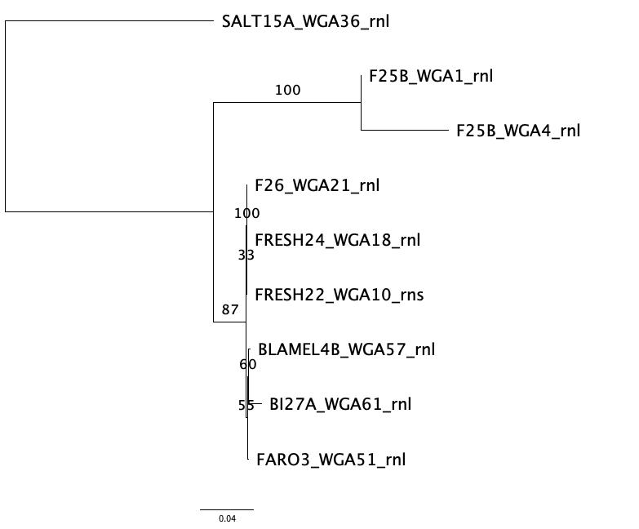
Mitochondrial phylogeny of host
Phylogenetic analysis of 16 concatenated mitochondrial genes,
IQ Tree

Slide 16
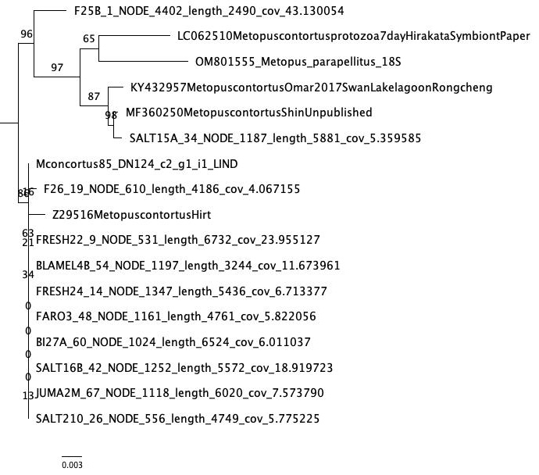
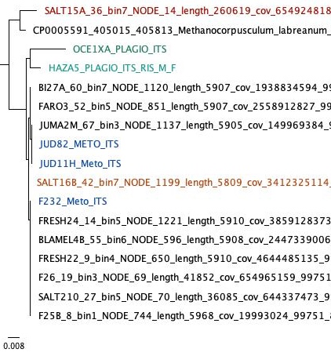
Symbiont Methanocorpusculum 16S & ITS phylogeny
Host ‘Hirsometopus’ spp. 18S phylogeny
RAxML 18S rRNA gene sequence tree
RAxML concatenated 16S rRNA gene & ITS sequence tree

Slide 17
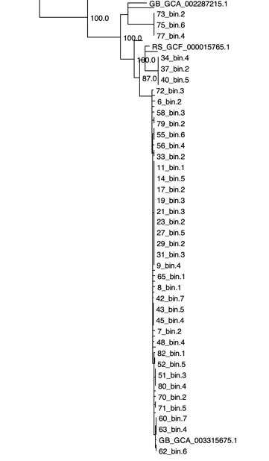
Metagenomic binning
& classification of symbionts
A complete to nearly complete Methanocorpusculum genomic bin from each cell of all 78 samples
Presence of 51 unique genes in nearly all
Classified as Methanocorpusculum sp. GCA_003315675.1 MCE in all but 1 metopid strain (SALT15A) and control Plagiopyla sp. unrelated host
Methanocorpusculum sp. MCE
  – most Metopid bins
  – bin FastANI ~ 99%
Methanocorpusculum labreanum-Z-like
  – SALT15A sp. 2 (cells/bins 34, 35, 36, 37, 38, 40, 81)
Methanocorpusculum parvum-like
  – JUMA2P Plagiopyla sp. (cells/bins 72 – 77)

Slide 18
Does it take two.. or three?
Most samples contained genomes of diverse sulfate reducing bacteria
  Desulfovibrionales, Desulfobacterales, Desulfarculales in ‘Hirsometopus’
  No obvious intraspecific variability – opportunistic symbionts?
  Deltaproteobacteria - SAR324-like in Plagiopyla
Six populations also host a 3rd symbiont – TC1 Firmicut
  Isolated from unrelated anaerobic ciliate Trimyema compressum, genome sequenced, Shinzato et al. 2016
  Function unknown – possibly synthesis of fatty acids

Slide 19
Intraspecific variability in symbionts of marine anaerobic ciliates
Geographically independent specific relationship suggesting co-diversification of methanogen and host
Single methanogen symbiotic strain in one host cell
Switches have occurred
Multipartite symbiosis of a ciliate with methanogens, sulfate-reducing bacteria, and firmicuts
Next steps
Assessment of symbiont gene content variation
Manuscript preparation

Slide 20
What we accomplished
Transfer from Brown to URI Andromeda HPC
Performed rDNA phylogenetic analyses of host and symbionts
Created pipelines for transcriptome assembly and metagenomic analyses
Transcriptome assembly, optimization, ORF prediction
Metagenomic assemblies and genome binning
Taxonomic classification of acquired genomes
Obtained host MRO genomes and performed phylogeny
Developed GitHub repository for scripts & pipelines

Slide 21
Lessons Learned
What went well?
  URI Andromeda IT assistance – thank you!
Challenges
  Estimating the duration of creating the pipeline and running jobs
  Data back up
  Building a pipeline better ”tailored” for the unique target organisms and method used
  Symbiont composition diverse and complex
  (challenging but exciting!)

Slide 22
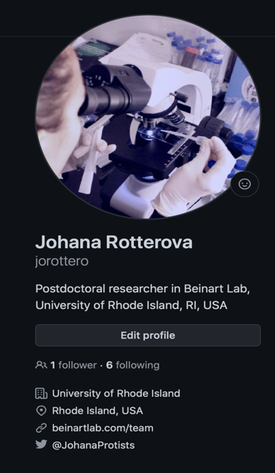
Contributions to Research
Computing Community
Github contributions
  https://github.com/jorottero/Metopid_host-symbiont_popgen
Protocols.io

Slide 23
Publications/Contributions
Conferences:
Past:
Schrecengost, A., Rotterova, J., Gutierrez, R., Beinart, R. A. Diversity of marine anaerobic ciliates and their associations with methanogenic symbionts. 8th Conference on Beneficial Microbes, July 10 – 14, 2022, Madison, Wisconsin, USA.
Daniel Méndez-Sánchez, D., Rotterova, J., Poláková, K., Schrecengost, A., Beinart, R. A., Čepička, I. Anoxic relationships: Anaerobic ciliates and methanogenic archaea. International Conference 51 Jirovec's Protozoological days, May 2022, Czech Republic.
Planned:
Rotterova, J., Breusing, C., Beinart, R. A. Population genomics analysis of diverse symbiotic consortium of marine anaerobic ciliates. EMBO EMBL Symposium: The cellular mechanics of symbiosis, March 08 – 11, 2023, Heidelberg, Germany.
Publications in prep:
Bourland, W., Rotterova, J., Beinart, R. A., Cepicka, I. Morphological and molecular characterization of two species of a new ciliate genus, Hirsometopus (Metopida, Ciliophora), in prep.
Mendez-Sanchez, D., Schrecengost, A., Rotterova, J., Beinart, R. A., Cepicka, I. The diversity and coevolution of methanogenic endosymbionts of anaerobic ciliates (Metopida, Ciliophora), in prep.
Schrecengost, A., Rotterova, J., Cepicka, I., Beinart, R. A. Rumen methanogen forms a symbiosis with unrelated marine anaerobic ciliates, in prep.

Slide 24



Acknowledgements
Gaurav Khanna (URI)
Kevin Bryant (URI)
Careers Cyberteam

